Slide 1
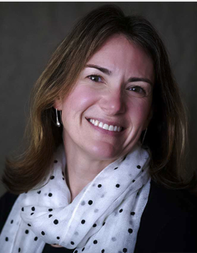
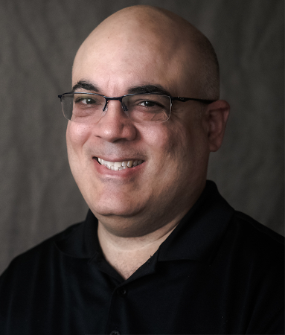
Introductions
Lynn McCormack
Senior Technologist
CAST
Luis Perez
Technical Assistance Specialist
AEM Center at CAST

Slide 2
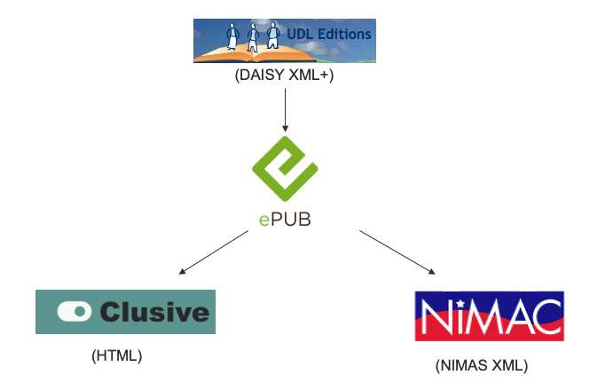
Workflow for Developing NIMAS Fileset

Slide 3
Resources
FAQ on the May 2020 NOI: NIMAS and Digital Materials (AEM Center)
All About Coyotes can be viewed on Clusive (clusive.cast.org)
Exemplar: Creating NIMAS from a Digital Material

Slide 4
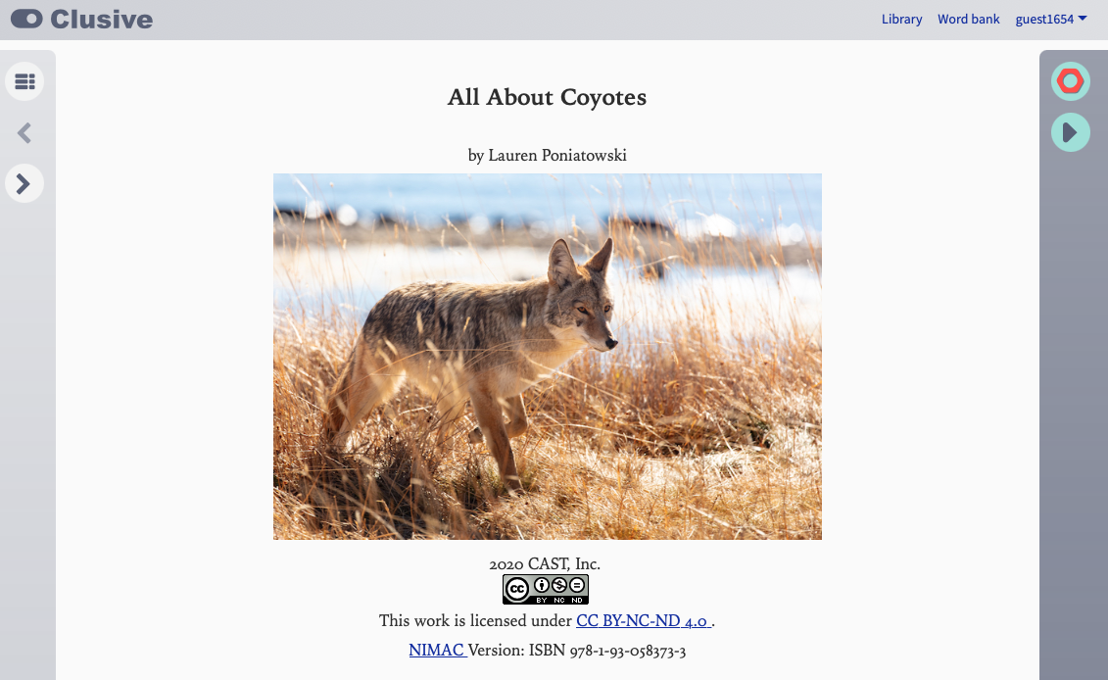
Source Content for Exemplar
clusive.cast.org

Slide 5
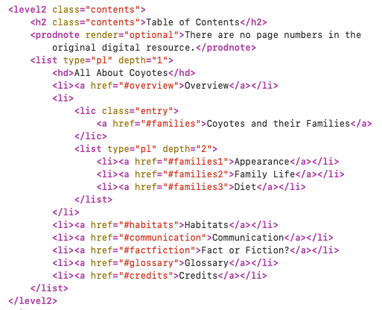
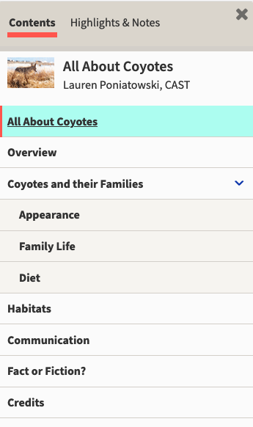
Table of Contents

Slide 6
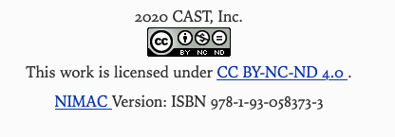
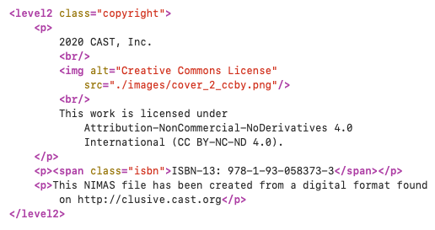
License

Slide 7
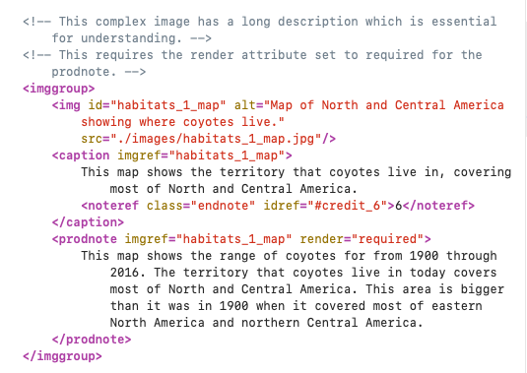
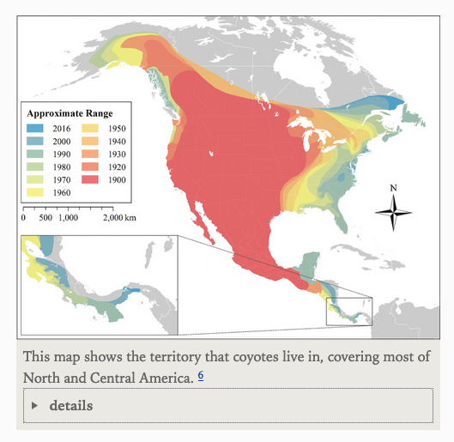
Image Resolution and Description

Slide 8
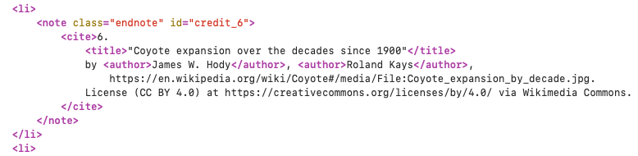
Images Attributions

Slide 9
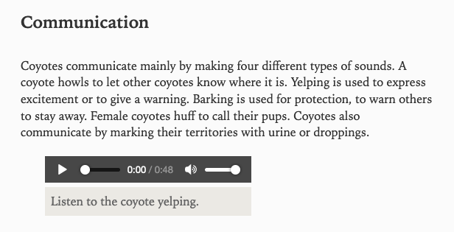
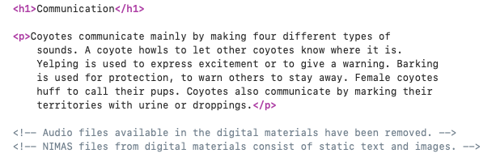
Interactive Components

Slide 10
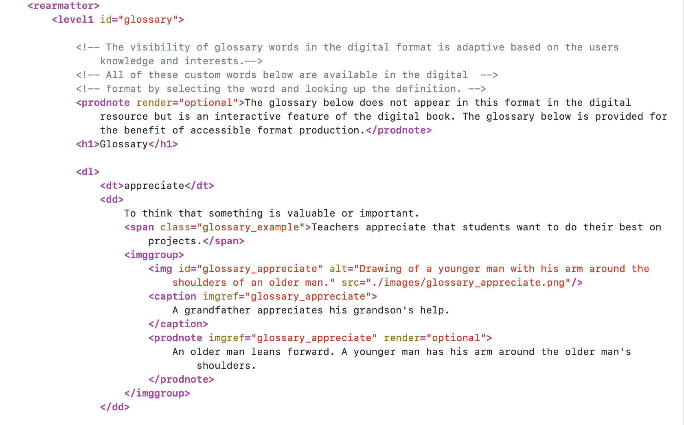
Glossary

Slide 11
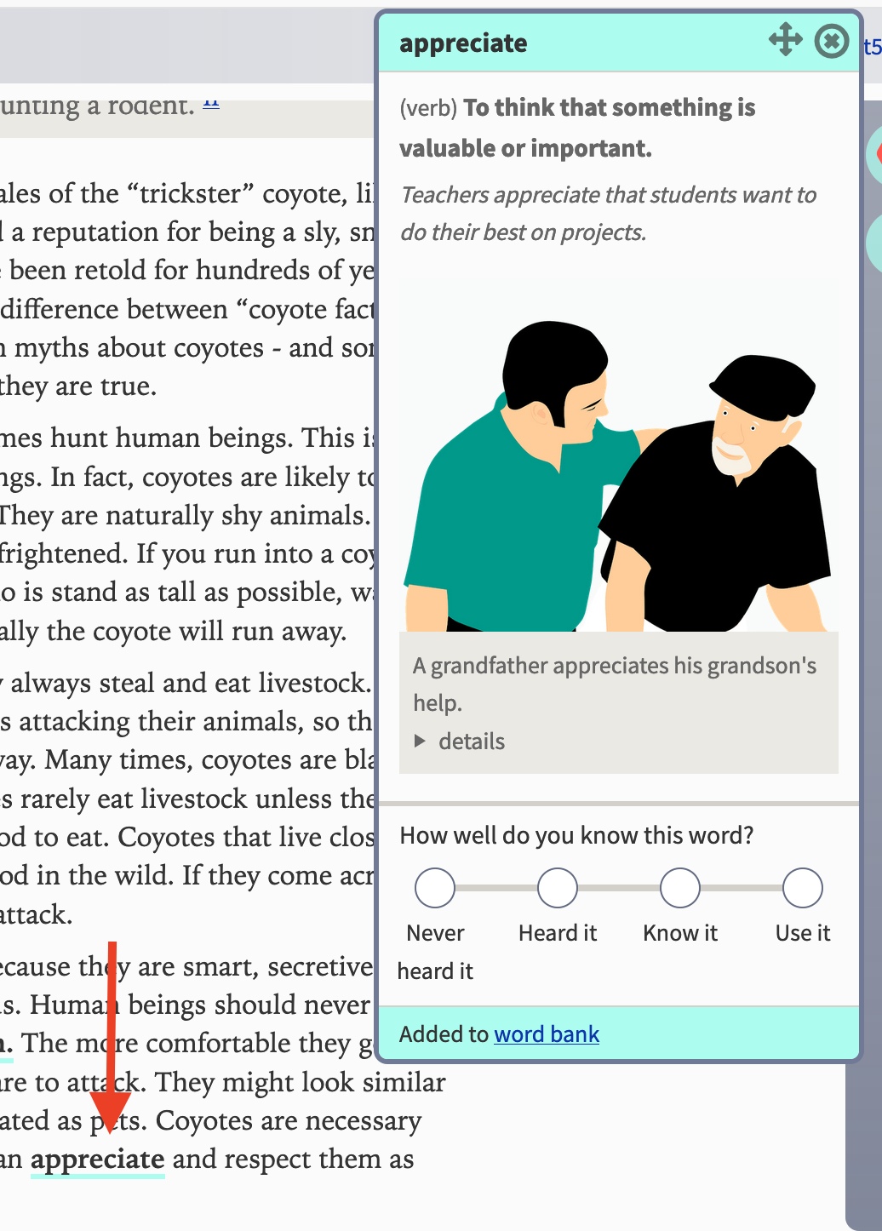
Glossary Entry

Slide 12
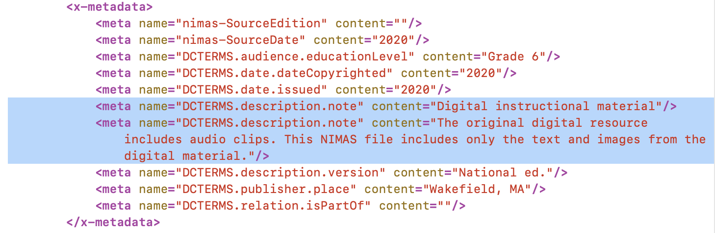
OPF Notes

Slide 13
Reference Materials
FAQ on the May 2020 NOI: NIMAS and Digital Materials (AEM Center)
All About Coyotes can be viewed on Clusive (clusive.cast.org)
Exemplar: Creating NIMAS from a Digital Material

Slide 14

Connect with Us!
Lynn: lmccormack@cast.org
Luis: lperez@cast.org
AEM Center: aem@cast.org

Slide 15
Disclaimer
The contents of this slide deck were developed under a cooperative agreement with the U.S. Department of Education, #H327Z190004. However, those contents do not necessarily represent the policy of the U.S. Department of Education and you should not assume endorsement by the Federal Government, Project Officer, Rebecca Sheffield, Ph.D.

