Slide 1
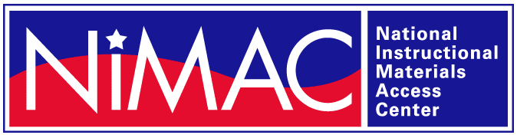
The NIMAC & NIMAS:
An Introduction & Overview
April 16, 2021

Slide 2
NIMAC Overview

Slide 3
The NIMAC Project
  Created by IDEA 2004, the National Instructional Materials Access Center is the national source file repository for K-12 textbooks and instructional materials.
  We make digital files (in NIMAS format) available to states for use in producing accessible formats for students.
  To date, we have received over 65,000 file sets from almost 160 publishers.
  All 50 states plus 7 outlying areas work with the NIMAC.

Slide 4
The Purpose of the NIMAC
IDEA 2004 created the NIMAC (and the NIMAS file format) to make it faster to produce accessible formats for use by students who are blind, visually impaired or have print disabilities.
Having a NIMAS file available can “jump start” accessible media production, increasing the timely delivery of materials to students.

Slide 5
What does the NIMAC do?
The NIMAC receives NIMAS files from K-12 publishers and makes these files available to users in the states who are involved in producing accessible formats.
Over 350 users across the U.S. are registered with the NIMAC.
Bookshare, for example, is a major provider that uses NIMAS files to produce EPUB, DAISY, and other digital formats for use by students with disabilities.

Slide 6
Services to States
There is no cost to states or users to download files from the NIMAC.
States designate authorized users who can access the repository.
Accessible media producers can also register with the NIMAC.
NIMAS files are not distributed directly to students, so NIMAC does not generally work with individual schools.

Slide 7
Students and NIMAS
Schools generally obtain accessible formats for their students directly from organizations that produce these formats.
However, if a school or district has capacity (i.e., software and expertise) to produce its own accessible formats from NIMAS, they are welcome to register with the NIMAC as an accessible media producer.

Slide 8
Getting Connected in Your State
Every state has a NIMAC State Coordinator and Authorized Users who are involved in getting accessible formats produced and distributed to eligible students.
If you need help getting connected in your state, please don’t hesitate to reach out to us at nimac@aph.org.

Slide 9
Bookshare and NIMAS
Bookshare has a grant through the U.S. Department of Education to provide NIMAS-sourced digital formats free of charge to eligible K-12 students.
Most states have designated Bookshare as a NIMAC Authorized User to facilitate this work.
For more information, visit: https://www.bookshare.org/cms/

Slide 10
NIMAC and IDEA 2004:
Scope and Definitions

Slide 11
What is NIMAS?
  NIMAS is the National Instructional Materials Accessibility Standard.
  Based on the DAISY standard, NIMAS is a source file format.
  This means that the files are not designed to be directly used by a student, but are the starting point for producing other formats.

Slide 12
What formats are produced from NIMAS?
  NIMAS is used to produce formats such as braille, large print, DAISY, digital audio, and EPUB.
  NIMAS is the only file format that the NIMAC receives.

Slide 13
NIMAS eligibility
  To be eligible to receive accessible formats that have been produced from NIMAS files, students are required to:
    Have an Individualized Education Program (IEP)
    Have a qualifying disability, per the eligibility criteria of the National Library Service for the Blind and Print Disabled (NLS)

Slide 14
Updated NLS Guidelines
  In February of 2021, the NLS published revised eligibility guidelines.
  The changes have made it easier for states to certify students with dyslexia and other reading disabilities as qualifying for NIMAS.
  The pool of professionals who can certify eligibility has expanded.
  A medical doctor is no longer required to certify students as eligible due to a reading disability.

Slide 15
Updated NLS Guidelines
  For more information and the full language of the new NLS guidelines, a downloadable resource can be found here: NIMAC and the NLS Updates 2021

Slide 16
NIMAS and 504 Students
  Unfortunately, students who are served under 504 are not currently eligible to receive materials produced from NIMAS files.
  This is due to the eligibility language in the IDEA 2004 legislation.
  The NIMAC continues to work with the U.S Department of Education and other stakeholders to explore avenues to address this exclusion.

Slide 17
NIMAS & Procurement
  Under IDEA 2004, the only mechanism to require NIMAS from the publisher is by states and districts including this requirement in textbook adoption contracts or purchase agreements.
  However, NIMAC is happy to request a file from a publisher for you if we don’t already have it.

Slide 18
Locating Accessible Materials

Slide 19
Locating Materials
  Anyone is welcome to search the NIMAC at any time: https://nimac.us.
  However, when seeking accessible formats for students with print disabilities, currently it may be most helpful to search Bookshare (https://www.bookshare.org) or Learning Ally (https://learningally.org/) directly to locate materials in digital or audio formats.
  For students who are blind or visually impaired, the best resource is Louis (https://louis.aph.org).

Slide 20
Learning Ally
  Learning Ally is a subscription-based service that provides high-quality audio formats for K-12 instructional materials.
  At this time, Learning Ally does not provide any materials produced from NIMAS.
  However, they are an important resource for many schools and districts for serving students with dyslexia and other print disabilities.
  For more information, visit: https://learningally.org/

Slide 21
Louis Plus
  In the summer of 2021, APH will be launching a new Louis Plus unified search website.
  This site will allow users to search Louis, Bookshare, Learning Ally, and the NIMAC in one search.
  If you need assistance locating accessible materials for students, or getting in touch with individuals in your state who work with NIMAS, don’t hesitate to contact us!

Slide 22
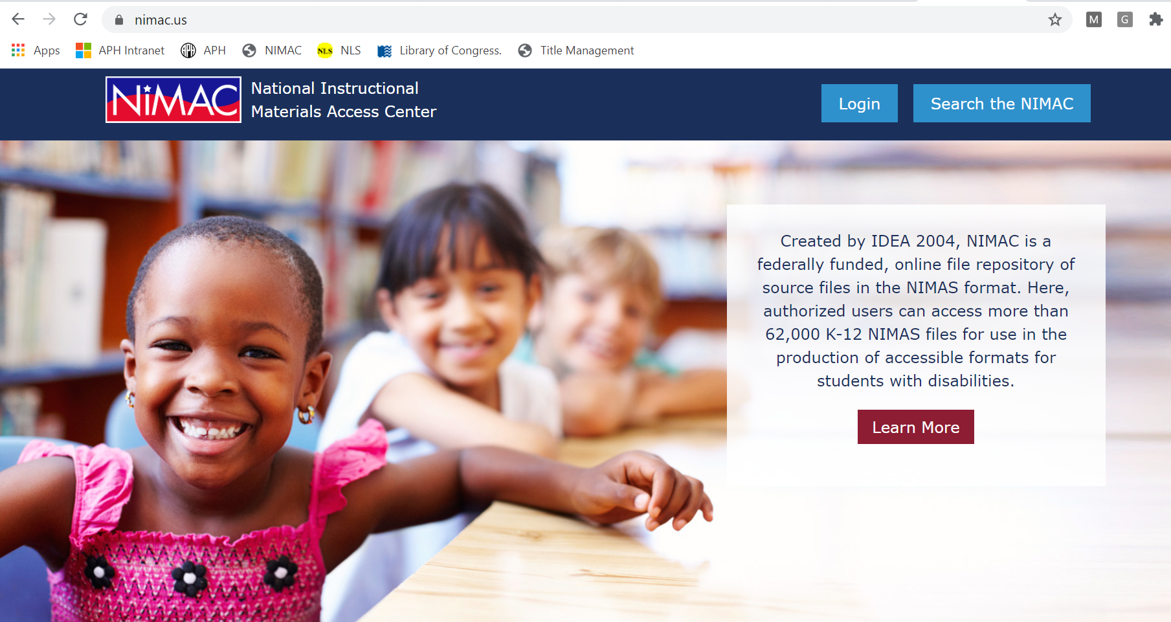
Visit us at https://nimac.us for more information and resources!

Slide 23
Contact us!
If you need help locating accessible materials or finding out how to get connected with resources in your state, please reach out:
nimac@aph.org
877-526-4622
The content of this resource was developed under a grant from the US Department of Education, #H327E160001. However, these contents do not necessarily represent the policy of the US Department of Education, and the reader should not assume endorsement by the Federal Government. Project Officer: Rebecca Sheffield.

