Slide 1

The NIMAC for AUs:
Basics, Updates, and a Demo
Liz Schaller, NIMAC Manager
eschaller@aph.org
March 16, 2022

Slide 2
Today’s Webinar
Part 1: PowerPoint
  NIMAC Basics
  Policy Updates
  Services & System Features for AUs
Part 2: Live Demo!
  Searching and Downloading
  Assigning Files to an AMP
  Using the Watchlist
  Publisher & AMP Contact Information
  Adding temporary sub users
  Reports

Slide 3
NIMAC: The Basics

Slide 4
The NIMAC Project
  Created by IDEA 2004, the NIMAC is the national source file repository for K-12 textbooks and instructional materials.
  We make NIMAS files available for use in producing accessible formats for K-12 instructional materials.
  We have over 67,000 file sets from almost 160 publishers.
  All 50 states plus 6 outlying areas and the DoDEA work with the NIMAC.

Slide 5
What is NIMAS?
  NIMAS is the National Instructional Materials Accessibility Standard.
  An XML-based source file format.
  Designed for use in producing formats such as braille, DAISY, EPUB, large print.
  It is not intended for distribution directly to students.
  NIMAS is the only format we receive.
  NIMAS is not a “by-product” of print or digital book production—it can take up to six weeks or more for NIMAS to be produced.

Slide 6
How we get files
  Under IDEA 2004, the only mechanism to require NIMAS from the publisher is the book adoption contract or purchase agreement.
  There is no blanket requirement for publishers to submit files to the NIMAC.
  States and districts have been able to require NIMAS when they purchase new textbooks since 2006.
  Ideally, when NIMAS is included in contracts, a file will already be available when a need is identified.

Slide 7
Types of materials we receive
  NIMAC receives a wide range of student-facing instructional materials.
  These include textbooks, workbooks, supplementary readers, and ancillary materials such as blackline masters.
  Exempt materials include teacher’s editions, pre-2006 titles, trade books, college textbooks, reference books.
  We can also now accept NIMAS files for some digital instructional materials.

Slide 8
What is an Authorized User?
An Authorized User is someone who has been designated by their State Coordinator to have an account that provides full access to the NIMAC repository.
These individuals are generally from within the educational structure of the state, such as from an IRC or state department of education.

Slide 9
Authorized Users & AMPs
  As an Authorized User, you can search and download files from the NIMAC.
  You can also assign files for download by registered Accessible Media Producers (AMPs).
  AMP accounts are freely available but provide more limited access to the repository.
  We’ll cover assigning files to AMPs in the demo.

Slide 10
NIMAC Policy Updates

Slide 11
New NLS Guidelines
In February of 2021, the National Library Service for the Blind and Print Disabled (NLS) updated its eligibility guidelines.
Changes to the guidelines included expanding the pool of professionals who can certify eligibility and eliminating the requirement that a medical doctor certify eligibility for individuals with reading disabilities.
Since IDEA 2004 points to the NLS guidelines for NIMAS, these changes also affected the NIMAC.

Slide 12
Updated Limitation of Use Agreement
To align our agreements with the new NLS guidelines, the NIMAC sent out updated Limitation of Use Agreements (LUAs) to all users last year.
To update your agreement, please download the LUA, initial each page, and fill in section 13.0.
You can email us the signed document at nimac@aph.org or mail in a hard copy.
The NIMAC can also now accept authenticated digital signatures, if you have DocuSign or other signature software available to you.

Slide 13
System Features and
Services for AUs

Slide 14
The Watchlist Research &
Expedite Service
  If a file you need is not available in the NIMAC, you probably will not have a way to know if it “should” be in the NIMAC or not.
  AU accounts have a built-in system feature where you can add the ISBN of a needed title to your Watchlist.
  NIMAC will research the item for you and try to obtain NIMAS for the title.

Slide 15
Watchlist Research
  If the title is within scope for NIMAS (i.e., not in an exempt category), we will request the file from the publisher.
  If the file is already in production, we may be able to expedite it for you.
  When the requested item becomes available in the NIMAC, you will receive an automated system email to let you know.
  If the file is outside of scope, we will research other accessibility alternatives and provide that information to you.

Slide 16
Side Note: Email Notifications
  The NIMAC system generates emails:
    when a Watchlist item becomes available
    when a sub user account is expiring
    when a download request has been processed and is ready (if you’ve selected this option)
  These emails show as sent by: noreply-NIMAC@overdrive.com
  Adding this address to your email contacts may prevent them from being filtered as spam.
  Contact us if you need further help.

Slide 17
MathML and NIMAS
MathML is optional XML markup for math and scientific notation.
The benefit of MathML is that, when software supports it, it can be used to automatically generate braille or other formats.
In the past, math was most often provided in NIMAS as images, which cannot automatically be converted into braille.

Slide 18
No MathML Download
Many publishers now provide MathML in their NIMAS files--however, not all software supports MathML.
If a NIMAS file includes MathML, but your software does not support MathML, you can choose to download the file without MathML.
We will show you this download option during the demo.

Slide 19
Does the file include MathML?
The NIMAC system will only show a “No MathML” download option if MathML is present in the file.
This is one easy way to know whether a file contains MathML.
There are also two other ways: looking at the system record or the XML file.

Slide 20

1. No MathML Download Option

Slide 21

2. MathML in the system record

Slide 22

3. MathML is mentioned at the top of the XML file

Slide 23
Producing Formats Using NIMAS
AMPs generally rely on proprietary software to produce accessible formats.
Providing training on how to use third-party software or set up production workflows is not generally under the purview of the NIMAC.
However, we are pleased to offer a special opportunity in late spring/early summer for braille transcribers.

Slide 24
Training for Transcribers
In May and June of 2022, the NIMAC will be hosting a series of training webinars for braille transcribers.
A separate course will be offered for users of Duxbury and for Braille 2000.
These courses will be provided free of charge and archived on the APH Hive.
We will be sharing more information soon!

Slide 25
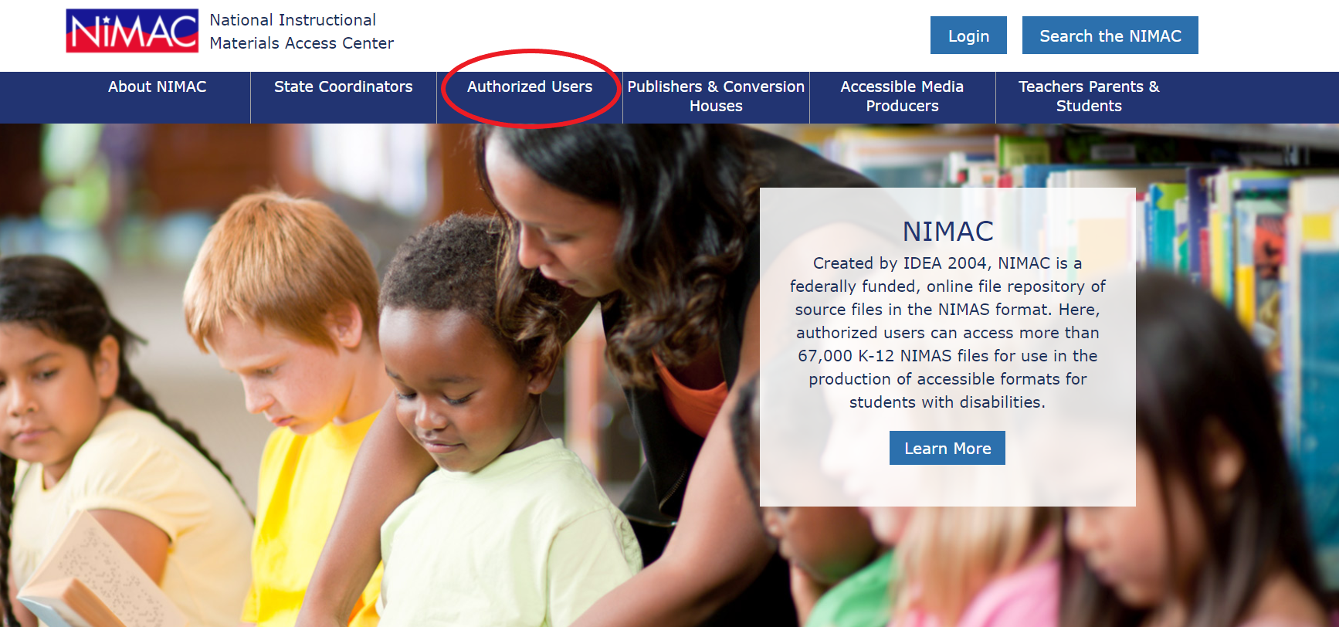

Slide 26
Live Demo: Your AU Account

Slide 27
What we’ll cover!
Basics
  Searching
  Downloading
  Assigning Files to an AMP
Additional System Features
  The Watchlist
  Publisher & AMP Contact Information
  Adding sub users
  Reports

Slide 28
Any Questions?
For any questions about how to use NIMAC or the status of files in the NIMAC system please contact us for assistance:
nimac@aph.org
877-526-4622
The content of this resource was developed under a grant from the US Department of Education, #H327E210001. However, these contents do not necessarily represent the policy of the US Department of Education, and the reader should not assume endorsement by the Federal Government. Project Officer: Rebecca Sheffield.

