Slide 1

NIMAC for Publishers and Vendors:
Basics & Working in the System
Liz Schaller Nicole Gaines
NIMAC Manager NIMAC Project Director
June 1, 2022

Slide 2
Today’s Webinar
Part 1: PowerPoint
  NIMAC basics
  Publisher accounts
  File review process
Part 2: Live Demo!
  Create user accounts
  Manage/upload inventory
  Generate reports
  Download inventory

Slide 3
Mark your calendar!
For a more in-depth look at the technical side of preparing and submitting files to the NIMAC, please join us for the second part of this 2-part series:
File Validation & Delivering Files to the NIMAC
  Monday, June 20, 2pm ET
  Wednesday, June 22, 9am ET

Slide 4
NIMAC: The Basics

Slide 5
The NIMAC Project
  Created by IDEA 2004, the National Instructional Materials Access Center is the national source file repository for K-12 textbooks and core instructional materials.
  We make NIMAS files available for use in producing accessible formats for K-12 instructional materials.
  Files in the NIMAC are not distributed directly to students.

Slide 6
The NIMAC Project
  The NIMAC has been in continuous operation since it opened in December of 2006.
  States and districts have been able to require NIMAS in their textbook contracts since July of 2006.
  To date, we have received over 69,000 file sets from 160 publishers.
  Over 46,000 files have been downloaded for use in producing accessible formats for students with disabilities.

Slide 7
States and the NIMAC
IDEA does not require that states work with the NIMAC, but all 50 states (and the six eligible territories and DoDEA) have chosen to do so.
States that do coordinate agree to:
  Require NIMAS from publishers in their textbook adoption contracts
  Abide by the eligibility requirements of IDEA and copyright law in the use of NIMAS files
  Designate and manage a small number of Authorized Users for their state

Slide 8
How NIMAC works with States
Access to the NIMAC is centralized.
Each state that coordinates names a NIMAC State Coordinator at the state department of education.
This individual is responsible for designating and managing the Authorized Users (AUs) who can access the repository and download files.
AUs may also assign files for download to registered Accessible Media Producers working on behalf of the state.

Slide 9
NIMAS eligibility
  IDEA 2004 defines the eligibility requirements for receiving materials produced from NIMAS.
  These materials can only go to elementary and secondary school students who have:
    A qualifying disability per the eligibility guidelines of the National Library Service for the Blind and Print Disabled (NLS)
    An Individualized Education Program (IEP)
  NIMAC is not involved in determining eligibility for individual students: this is a responsibility of the student’s school district.

Slide 10
The NIMAS Specification
  NIMAS is the National Instructional Materials Accessibility Standard.
  An XML-based source file format based on the DAISY standard.
  Designed for use in producing formats such as braille, DAISY, EPUB, and large print.
  It is not intended for distribution directly to students.
  NIMAS is the only format we receive.

Slide 11
Changes to the Standard
  As a format that is defined in the IDEA 2004 regulations, the specification itself can only be updated through legislative or regulatory action.
  The NIMAC itself is not able to make changes to the spec or broaden the formats we can receive.
  However, when IDEA 2004 is reauthorized (it is many years behind schedule for this), there will be an opportunity to make changes.

Slide 12
Materials within Scope for NIMAS
Under IDEA, the NIMAS is to receive:
  “printed textbooks and related printed core materials that are
  written and published primarily for use in elementary school and secondary school instruction and
  required by a state education agency (SEA) or local education agency (LEA)
  for use by students in the classroom.”

Slide 13
Range of Materials Received
  Neither OSEP nor the NIMAC imposes a definition of “core.”
  The NIMAC accepts a range of student-facing materials, including:
    Textbooks
    Workbooks
    Supplementary readers
    Ancillary materials (e.g., blackline masters).

Slide 14
NIMAS Exempt Materials
  Materials that the NIMAC does not generally receive include:
    Trade books
    College textbooks
    Reference books
    Materials published before 2006
    Teacher’s editions or ancillaries for the exclusive use of the teacher

Slide 15
“Notice of Interpretation”
In May 2020, the U.S. Department of Education (OSERS/OSEP) published a Notice of Interpretation clarifying that the definition of “print instructional materials” in IDEA includes digital instructional materials.
We can now accept files for digital materials if the content can be supplied in NIMAS format.
The NIMAS file format, designed to capture the static content of print books, has not changed.

Slide 16
Digital Materials & NIMAS
Digital materials composed primarily of static text and images (and which have a unique ISBN) can generally be converted into NIMAS.
Digital products that are interactive (e.g., games, software, videos) are not suitable for NIMAS.
The NOI also indicates that digital materials that meet established accessibility standards (WCAG 2.0 AA) are exempt from NIMAS.
For more information, please see our FAQ on NIMAS & Digital Materials.

Slide 17
Research on Digital Instructional Materials & Accessibility
We are currently working with an independent researcher, Dr. Penny Rosenblum, to investigate the state of accessibility of K-12 digital instructional materials and explore the technical assistance needs around providing NIMAS for these materials.
We would love to hear from you for this study!
If you are willing to participate in a one-hour interview or focus group, please contact us at nimac@aph.org.

Slide 18
NIMAC Requests to Publishers
The mechanism to require NIMAS is the textbook contract.
However, given that there are about 13,800 school districts in the U.S., the language is not always included in district contracts.
The NIMAC will reach out to publishers to request a file when there is a need for braille or another accessible format for an eligible student.
We greatly appreciate publishers’ assistance and support of students in response to these requests.

Slide 19
Connecting Customers with Accessible Formats
If you are helping your customers locate accessible formats for your materials, the best resource is the Louis Database of Accessible Materials.
We are also happy to help your customers locate materials or help them get connected to resources in their state.

Slide 20
Publisher Accounts &
File Review Process

Slide 21
Publisher Accounts
Accounts are made available to publishers that allow you to:
  Upload smaller files directly to the NIMAC system (up to 250 MB)
  Search, view or download your inventory
  Export inventory reports
  Create additional accounts for vendors or others at your company
  Download the NIMAC Validation Wizard
  Generate correctly formatted OPF metadata using the Excel to OPF tool

Slide 22
File Review & Certification
To be accepted into the NIMAC, files must pass the automated validation (upon upload) and a manual quality check of the files and metadata by NIMAC staff.
When files are certified, the publisher “super user” receives an email with the digital certificate number.
You can also add up to three additional email addresses to receive these emails.
These numbers can also be accessed in the full record or your inventory report.

Slide 23
File Review Checks
NIMAC staff review the metadata submitted with the file set to ensure it is correct and complete.
There are some additional checks to the XML to ensure that some required tags are present and that common elements like the TOC and glossary are tagged correctly.
We will also make a quick review of alt text.
NIMAC does not receive print books and does not do a page-by-page comparison to evaluate the tagging in the XML.

Slide 24
File Feedback
NIMAC staff can make metadata corrections in the system without requiring that files be resubmitted.
However, if a file has a problem in the XML or PDF, we will send detailed feedback so the file can be corrected and resubmitted as quickly as possible.
This feedback will generally be sent to the person who delivered or uploaded the file.

Slide 25
File Review Timeline
The time for a delivery to be reviewed and certified varies depending on the number of files received at a given time and the number of files in the review queue.
During times of light submissions, a file may be certified the day it is uploaded to the system.
If a delivery is large or many other files are in the queue, it may take 1-2 weeks or longer.

Slide 26
Certification Deadlines
Please let us know at the point of file submission if you have a deadline with a customer.
We encourage you to submit files at least two weeks in advance of a deadline.
This helps ensure that if there are any issues, your vendor will have time to make the needed corrections.
Files are usually certified in the order received, but we are happy to prioritize files to help a publisher meet a deadline.

Slide 27
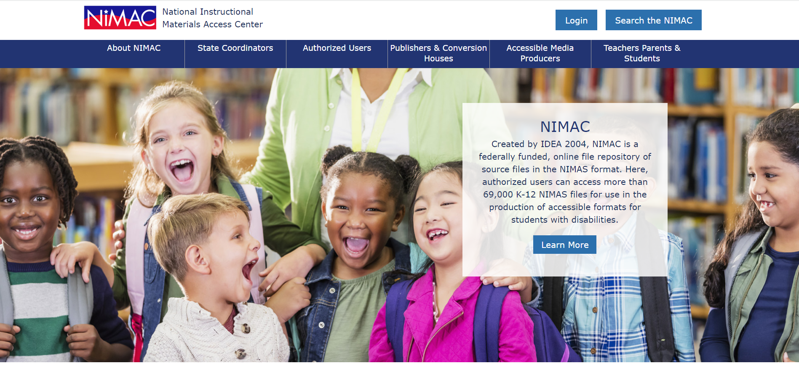
NIMAC Homepage

Slide 28
Live Demo

Slide 29
Questions?
For any questions about the status of files in the NIMAC system, feedback provided by our staff, or anything else, don’t hesitate to get in touch:
nimac@aph.org
877-526-4622
The contents of this resource was developed under a grant from the US Department of Education, #H327E210001. However, these contents do not necessarily represent the policy of the US Department of Education, and the reader should not assume endorsement by the Federal Government. Project Officer: Rebecca Sheffield.

