Slide 1

The NIMAC for AMPs:
Basics, Updates, and a Demo
Liz Schaller, NIMAC Manager
eschaller@aph.org
Nicole Gaines, NIMAC Project Director
ngaines@aph.org
April 19, 2023

Slide 2
Today’s Webinar
Part 1: PowerPoint
  NIMAC Basics
  Policy Updates
  Services & System Features for AMPs
Part 2: Live Demo!
  Your Account Information & Sub Users
  Publisher Contact Information
  Reports
  Using the Watchlist
  Downloading & Managing File Assignments
  Searching

Slide 3
NIMAC: The Basics

Slide 4
The NIMAC Project
  Created by IDEA 2004, the NIMAC is the national source file repository for K-12 textbooks and instructional materials.
  We make NIMAS files available for use in producing accessible formats for K-12 instructional materials.
  We have over 72,000 file sets from over 160 publishers.
  All 50 states plus 6 outlying areas and the DoDEA work with the NIMAC.

Slide 5
What is NIMAS?
  NIMAS is the National Instructional Materials Accessibility Standard.
  An XML-based source file format.
  Designed for use in producing formats such as braille, DAISY, EPUB, large print.
  It is not intended for distribution directly to students.
  NIMAS is the only format we receive.
  NIMAS is not a “by-product” of print or digital book production—it can take up to six weeks or more for NIMAS to be produced.

Slide 6
How we get files
  Under IDEA 2004, the only mechanism to require NIMAS from the publisher is the book adoption contract or purchase agreement.
  There is no blanket requirement for publishers to submit files to the NIMAC.
  States and districts have been able to require NIMAS when they purchase new textbooks since 2006.
  Ideally, when NIMAS is included in contracts, a file will already be available when a need is identified.

Slide 7
Types of materials we receive
  NIMAC receives a wide range of student-facing instructional materials.
  These include textbooks, workbooks, supplementary readers, and ancillary materials such as blackline masters.
  Exempt materials include teacher’s editions, pre-2006 titles, trade books, college textbooks, reference books.
  We can also now accept NIMAS files for some digital instructional materials.

Slide 8
What is an Authorized User?
An Authorized User is someone who has been designated by their State Coordinator to have an account that provides full access to the NIMAC repository.
They can search and download files or assign files to registered Accessible Media Producers (AMPs).
These individuals are generally from within the educational structure of the state, such as from an IRC or state department of education.

Slide 9
What is an AMP account?
An Accessible Media Producer (AMP) account allows the user to download any file assigned to them by an Authorized User.
These accounts are freely available to any organization or individual who can work with NIMAS to produce accessible formats for K-12 students with print disabilities.
These users do not have to be designated by a state coordinator, but they have more limited access to download files.

Slide 10
Should I be an AU?
If you need direct access to download files from the system, it may be appropriate for you to be designated as an Authorized User for a given state.
To become an AU, you need to be a part of the educational structure of the state, or a non-profit that qualifies as an “authorized entity” under Chafee.
Feel free to contact the NIMAC if you have questions or would like more information.

Slide 11
Side Note: the APH AMP Directory
AMP information in the NIMAC is not public.
AUs can only access information about AMPs through their NIMAC accounts.
If you are interested in sharing information publicly about the services you offer, we invite you to participate in the Accessible Media Producers Directory.
This searchable online directory is a free service of APH (separate from the NIMAC).
Contact resource@aph.org for more information!

Slide 12
NIMAS File Assignment

Slide 13
File Assignment
Once you have an active AMP account, any Authorized User in any state can assign you files for download.
If you are working on a project for a state or district and need help locating an AU in that state to assign you the NIMAS file, just let us know.

Slide 14
Email Notification
Whenever you are assigned a file by an Authorized User, the system will send an automated email to let you know that the file is available for download in your queue.
The notification will let you know what item has been assigned, what accessible format is being requested, and what user made the assignment.

Slide 15
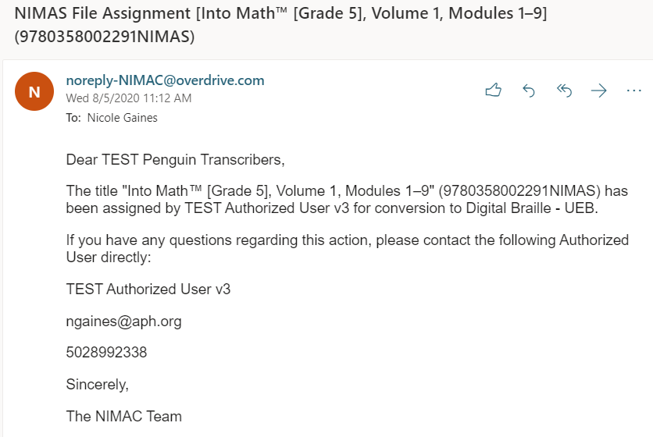
Example of File Assignment Email

Slide 16
Spam Filter Heads Up
All automated emails from the NIMAC will show as the sender noreply-NIMAC@overdrive.com.
Some email systems will filter out automated emails unless you “whitelist” the sender.
If you encounter any issues receiving emails, please add this address to your contacts.
You may need to get help from your IT administrator if network restrictions prevent system emails from getting through.
Contact the NIMAC for further assistance.

Slide 17
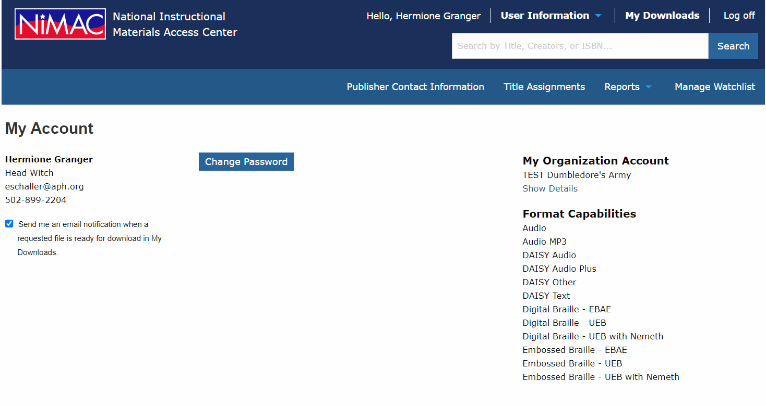
AMP Format Capabilities

Slide 18
Updating Format Capabilities
Format capabilities are selected when a new AMP registers with the NIMAC.
They can be viewed at any time by going to User Information → My Account.
Format information is provided as a convenience for AMPs and the Authorized Users who are assigning them files.
Formats should be updated whenever needed to reflect changes in what you produce.
Please contact us at nimac@aph.org if you need to update your information.

Slide 19
Format Capabilities Options
The NIMAC is in the process of reviewing the format capability options that are available in the system.
The list is due for having some outdated formats removed and some new ones added.
We are interested in your input!
On the next screen is the current list of options.
The options we are considering removing are in column two.

Slide 20
Current Format Capability Options
Audio
Audio MP3
DAISY Other
DAISY Text
Digital Braille - UEB
Digital Braille - UEB with Nemeth
Embossed Braille - UEB
Embossed Braille - UEB with Nemeth
Large Print
Other
Options we may remove:
DAISY Audio
DAISY Audio Plus
Embossed Braille – EBAE
Digital Braille - EBAE
What should be added? PDF? EPUB?

Slide 21
NIMAC Policy Updates

Slide 22
New NLS Guidelines
In February of 2021, the National Library Service for the Blind and Print Disabled (NLS) updated its eligibility guidelines.
Changes to the guidelines included expanding the pool of professionals who can certify eligibility and eliminating the requirement that a medical doctor certify eligibility for individuals with reading disabilities.
Since IDEA 2004 points to the NLS guidelines for NIMAS, these changes also affected the NIMAC.

Slide 23
Updated NIMAC Limitation of Use Agreement
To align our agreements with the new NLS guidelines, the NIMAC sent out updated Limitation of Use Agreements (LUAs) to all users in 2021.
If you haven’t completed a LUA since May 2021, please download the LUA, initial each page, and fill in section 14.0.
If you aren’t sure if you’ve submitted an updated LUA or not, please reach out.

Slide 24
System Features and
Services for AMPs

Slide 25
The Watchlist Research &
Expedite Service
  If a file you need is not available in the NIMAC, you probably will not have a way to know if it “should” be in the NIMAC or not.
  AMP accounts now have a built-in system feature where you can add the ISBN to your Watchlist.
  NIMAC will research the item for you and try to obtain NIMAS for the title.

Slide 26
Watchlist Research
  If the title is within scope for NIMAS (i.e., not in an exempt category), we will request the file from the publisher.
  If the file is already in production, we may be able to expedite it for you.
  When the Watchlist ISBN is available in the NIMAC, you will receive an automated email to let you know.
  If the file is outside of scope, we will research other accessibility alternatives and provide that information to you.

Slide 27
MathML and NIMAS
MathML is optional XML markup for math and scientific notation.
The benefit of MathML is that, when software supports it, it can be used to automatically generate braille or other formats.
In the past, math was most often provided in NIMAS as images, which cannot automatically be converted into braille.

Slide 28
No MathML Download
Many publishers now provide MathML in their NIMAS files--however, not all software supports MathML.
If a NIMAS file includes MathML, but your software does not support MathML, you can choose to download the file without MathML.
We will show you this download option during the demo.

Slide 29
Does the file include MathML?
The NIMAC system will only show a “No MathML” download option if MathML is present in the file.
This is one easy way to know whether a file contains MathML.
There are also two other ways: looking at the system record or the XML file.

Slide 30

1. “No MathML” shows as a download option

Slide 31

2. MathML in the system record

Slide 32

3. MathML is mentioned at the very top of the XML file

Slide 33
Working with NIMAS Files

Slide 34
Tools for Working with NIMAS
While there are some good tools available for working with NIMAS--especially for braille production--it can be more difficult to locate software to generate other formats.
The NIMAC is working to provide more information to users about available resources.
If you have software that you’d like to be sure other AMPs know about, please let us know.
We are also working with the DAISY Consortium this year to upgrade the free DAISY Pipeline tool so that it supports NIMAS conversion.

Slide 35
Input on the NIMAS Specification
The NIMAC is also currently exploring the possibility of updating the NIMAS specification.
If you are “in the weeds” on the more technical side of NIMAS and have ideas on what would improve the format, we would like to hear from you.
For example, proposed changes might include making alt text and/or MathML required for NIMAS rather than optional.
We will also be gathering input more systematically in the coming year.

Slide 36
Producing Braille with NIMAS
Last year, the NIMAC hosted a series of training webinars for braille transcribers who use Braille 2000 or Duxbury.
If you weren’t able to attend, or if you’d like to revisit the trainings, you can find the archived videos and slides here.

Slide 37
Transcriber User Groups
We are considering setting up two transcriber User Groups (for Duxbury and Braille 2000 users) for ongoing support.
The groups will:
  Be relatively informal;
  Be facilitated by a skilled transcriber;
  meet bi-monthly or quarterly; and
  provide an opportunity for transcribers to connect and share information and pointers on textbook transcription.
Please let us know by emailing us at nimac@aph.org if you are interested in participating.

Slide 38
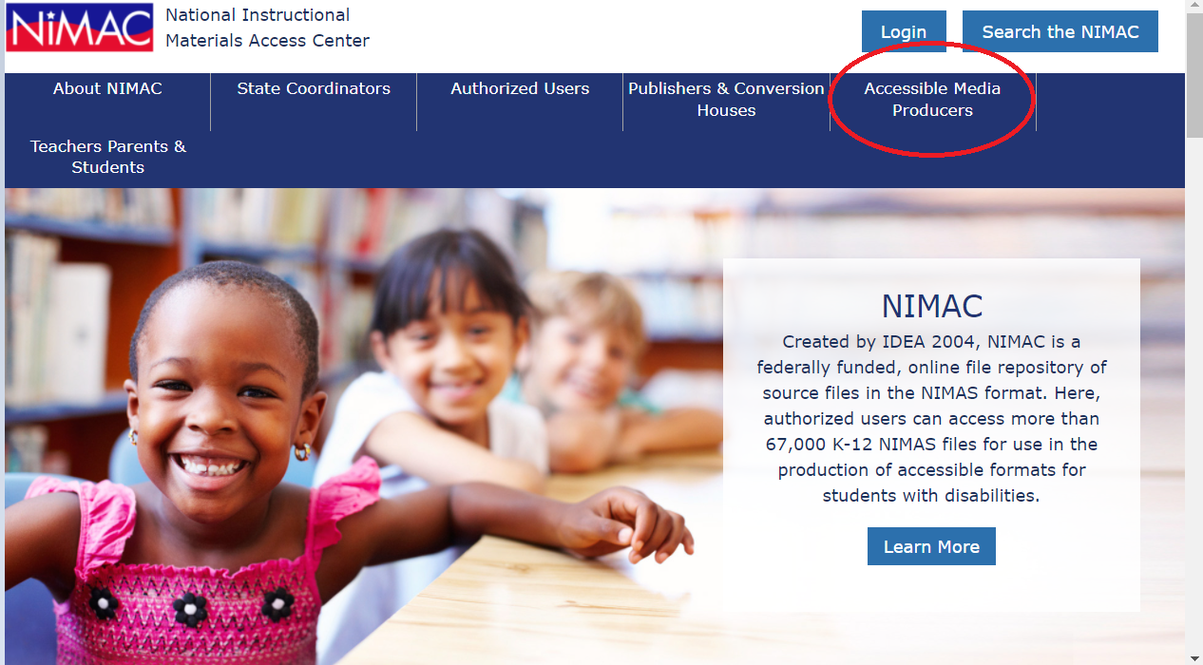
NIMAC Home Page

Slide 39
Live Demo: Your AMP Account

Slide 40
Demo!
  Your Account Information & Sub Users
  Publisher Contact Information
  Reports
  Using the Watchlist
  Downloading & Managing File Assignments
  Searching

Slide 41
Any Questions?
For any questions about how to use NIMAC or the status of files in the NIMAC system please contact us for assistance:
nimac@aph.org
877-526-4622
The content of this resource was developed under a grant from the US Department of Education, #H327E210001. However, these contents do not necessarily represent the policy of the US Department of Education, and the reader should not assume endorsement by the Federal Government. Project Officer: Rebecca Sheffield.

