Slide 1

The NIMAC for AUs:
Basics, Updates, and a Demo
Nicole Gaines, NIMAC Project Director
ngaines@aph.org
Liz Schaller, NIMAC Manager
eschaller@aph.org
April 6, 2023

Slide 2
Today’s Webinar
Part 1: PowerPoint
  NIMAC Basics
  Policy Updates
  Services & System Features for AUs
Part 2: Live Demo!
  Searching and Downloading
  Assigning Files to an AMP
  Using the Watchlist
  Publisher & AMP Contact Information
  Adding temporary sub users
  Reports

Slide 3
NIMAC: The Basics

Slide 4
The NIMAC Project
  Created by IDEA 2004, the NIMAC is the national source file repository for K-12 textbooks and instructional materials.
  We make NIMAS files available for use in producing accessible formats for K-12 instructional materials.
  We have over 72,000 file sets from 169 publishers.
  All 50 states plus the eligible territories and DoDEA work with the NIMAC.

Slide 5
What is NIMAS?
  “NIMAS” means the National Instructional Materials Accessibility Standard.
  Under IDEA, this is the only file format the NIMAC is allowed to receive.
  NIMAS is an XML-based source file format used to produce accessible formats such as braille, DAISY, EPUB, and large print.
  It is not distributed directly to students.
  Because NIMAS is not generated as a part of print or digital book production, it can take several weeks for it to be produced.

Slide 6
How we get files
  Under IDEA 2004, the only mechanism to require NIMAS from the publisher is the book adoption contract or purchase agreement.
  There is no blanket requirement for publishers to submit files to the NIMAC.
  States and districts have been able to require NIMAS when they purchase new textbooks since July of 2006.
  Ideally, when NIMAS is included in contracts, a file will already be available when a need is identified.

Slide 7
Types of materials we receive
  NIMAC receives a wide range of student-facing instructional materials.
  These include textbooks, workbooks, supplementary readers, and ancillary materials such as blackline masters.
  Exempt materials include teacher’s editions, pre-2006 titles, trade books, college textbooks, reference books.
  We can also now accept NIMAS files for some digital instructional materials.

Slide 8
What is an Authorized User?
An Authorized User is someone who has been designated by their State Coordinator to have an account that provides full access to the NIMAC repository.
These individuals are generally from within the educational structure of the state, such as from an IRC or state department of education.
In some states, the State Coordinator also functions as an Authorized User. We identify these individuals as “hybrid” State Coordinators.

Slide 9
Authorized Users & AMPs
  As an Authorized User, you can search and download files from the NIMAC.
  You can also assign files for download by registered Accessible Media Producers (AMPs).
  AMP accounts are freely available but provide more limited access to the repository.
  We’ll cover assigning files to AMPs in the demo.

Slide 10
NIMAC Policy Updates

Slide 11
New NLS Guidelines in 2021
In February of 2021, the National Library Service for the Blind and Print Disabled (NLS) updated its eligibility guidelines.
Since IDEA refers to these guidelines for NIMAS eligibility, these changes also impact the NIMAC.
The NLS expanded the pool of professionals who can certify eligibility and eliminated the requirement that a medical doctor certify eligibility for individuals with reading disabilities.
For more information, visit New NLS Guidelines.

Slide 12
System Features and
Services for AUs

Slide 13
The Watchlist Research &
Expedite Service
  If a file you need is not available in the NIMAC, you may not be certain if it “should” be in the NIMAC or not.
  AU accounts have a built-in system feature where you can add the ISBN of a needed title to your Watchlist.
  NIMAC will research the item for you and try to obtain NIMAS for the title, if the material is within scope for the repository.

Slide 14
Watchlist Research
  If the title is within scope for NIMAS (i.e., not in an exempt category), we will request the file from the publisher.
  If the file is already in production, we may be able to expedite it for you.
  When the requested item becomes available in the NIMAC, you will receive an automated system email to let you know.
  If the file is outside of scope, we will research other accessibility alternatives and provide that information to you.

Slide 15
Side Note: Email Notifications
  The NIMAC system generates emails:
    when a Watchlist item becomes available
    when a sub user account is expiring
    when a download request has been processed and is ready (if you’ve selected this option)
  These emails show as sent by: noreply-NIMAC@overdrive.com
  Adding this address to your email contacts may prevent them from being filtered as spam.
  Contact us if you need further help.

Slide 16
MathML and NIMAS
MathML is optional XML markup for math and scientific notation.
The benefit of MathML is that, when software supports it, it can be used to automatically generate braille or other formats.
In the past, math was most often provided in NIMAS as images, which cannot automatically be converted into braille.

Slide 17
No MathML Download
Many publishers now provide MathML in their NIMAS files--however, not all software supports MathML.
If a NIMAS file includes MathML but your software does not support it, you can choose to download the file without MathML.
We will show you this download option during the demo.

Slide 18
Does the file include MathML?
The NIMAC system will only show a “No MathML” download option if MathML is present in the file.
This is one easy way to know whether a file contains MathML.
There are also two other ways: looking at the system record or the XML file.

Slide 19

1. No MathML Download Option

Slide 20

2. MathML in the system record

Slide 21

3. MathML is mentioned at the top of the XML file

Slide 22
Braille 2000 and Duxbury Training Courses
In May and June of 2022, the NIMAC hosted a series of training webinars for braille transcribers.
The two 6-session courses covered braille transcription basics for working with NIMAS using Duxbury or Braille 2000
If you would like to refer back to these courses, you can find the archived videos and slide decks here.

Slide 23
Additional Training!
The NIMAC is looking for additional ways to support you! We can put together trainings for:
Your state or local team
Your local conference/PD
We would also like to hear from you about topics you’d like to see covered in a live training or reference material. Please email us your ideas at nimac@aph.org!

Slide 24
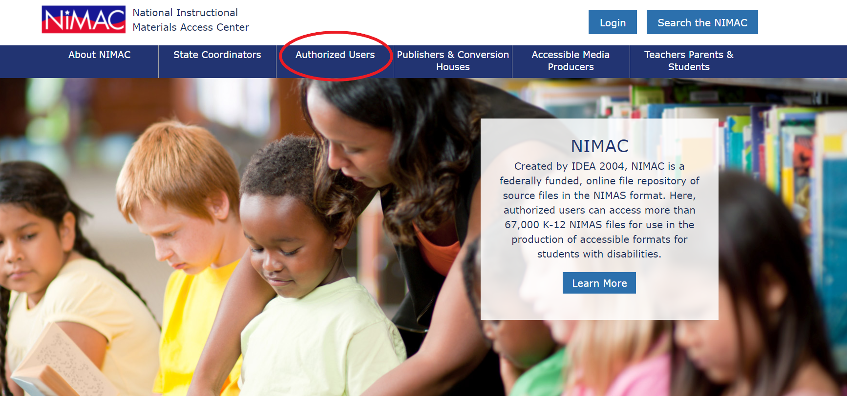
NIMAC Website

Slide 25
Live Demo: Your AU Account

Slide 26
What we’ll cover!
Basics
  Searching
  Downloading
  Assigning Files to an AMP
Additional System Features
  The Watchlist
  Publisher & AMP Contact Information
  Adding sub users
  Reports

Slide 27
Any Questions?
For any questions about how to use NIMAC or the status of files in the NIMAC system please contact us for assistance:
nimac@aph.org
877-526-4622
The content of this resource was developed under a grant from the US Department of Education, #H327E210001. However, these contents do not necessarily represent the policy of the US Department of Education, and the reader should not assume endorsement by the Federal Government. Project Officer: Rebecca Sheffield.

