Slide 1

NIMAC for Publishers and Vendors:
Basics & File Submission
Nicole Gaines, NIMAC Project Director
Liz Schaller, NIMAC Manager
June 2023

Slide 2
Today’s Webinar
Part 1: PowerPoint
  NIMAC basics
  Publisher accounts overview
  File validation
  File submission
  NIMAC file certification process
Part 2: Live Demo
  Manually adding/replacing files
  Creating additional user accounts
  Generating reports (optional feature)

Slide 3
Mark your calendar!
For a more in-depth look at the technical side of creating NIMAS files, please join us for the second part of this 2-part series:
NIMAS File Creation:
Resources & Best Practices
  Wednesday, June 28, 9am ET
  Thursday, June 29, 2pm ET

Slide 4
NIMAC: The Basics

Slide 5
The NIMAC Project
  Created by IDEA 2004, the National Instructional Materials Access Center is the national source file repository for K-12 textbooks and core instructional materials.
  We make NIMAS files available to states for use in producing accessible formats (such as braille) for qualifying students in K-12.
  Files in the NIMAC are not distributed directly to students.

Slide 6
The NIMAC Project
  The NIMAC has been in continuous operation since it opened in December of 2006.
  States and districts have been able to require NIMAS in their textbook contracts since July of 2006.
  To date, we have received over 73,000 file sets from 170 publishers.
  Over 50,000 files have been downloaded for use in producing accessible formats for students with disabilities.

Slide 7
States and the NIMAC
IDEA does not require that states work with the NIMAC, but all 50 states (and the six eligible territories and DoDEA) have chosen to do so.
States that coordinate agree to:
  Require NIMAS from publishers in their textbook adoption contracts
  Abide by the eligibility requirements of IDEA and copyright law in the use of NIMAS files
  Designate and manage a small number of Authorized Users for their state

Slide 8
How NIMAC works with States
Access to the NIMAC is centralized.
Each state that coordinates names a NIMAC State Coordinator at the state department of education.
This individual is responsible for designating and managing the Authorized Users (AUs) who can access the repository and download files.
AUs may also assign files for download to registered Accessible Media Producers working on behalf of the state.

Slide 9
NIMAS eligibility
  IDEA 2004 defines the eligibility requirements for receiving materials produced from NIMAS.
  These materials can only go to elementary and secondary school students who have:
    A qualifying disability per the eligibility guidelines of the National Library Service for the Blind and Print Disabled (NLS)
    An Individualized Education Program (IEP)
  NIMAC is not involved in determining eligibility for individual students.

Slide 10
The NIMAS Specification
  NIMAS is the National Instructional Materials Accessibility Standard.
  An XML-based source file format based on the DAISY standard.
  Designed for use in producing formats such as braille, DAISY, EPUB, and large print.
  It is not intended for distribution directly to students.
  NIMAS is the only format the NIMAC can receive.

Slide 11
Changes to NIMAS
  As a format that is defined in the IDEA 2004 regulations, the technical specification can only be updated through legislative or regulatory action.
  The NIMAC itself is not able to make changes to the NIMAS, aside from minor changes to metadata requirements.
  Because IDEA 2004 is many years overdue for reauthorization, the NIMAS standard has not been updated since the IDEA regs were published.

Slide 12
Gathering Stakeholder Input
  Throughout 2023 and 2024, the NIMAC will be reaching out to a range of stakeholders to get input on what changes, if any, they would like to see to the specification.
  We are interested in publishers’ and vendors’ input on how the specification could be improved.
  Input may support a formal request to the Department to update the specification through regulatory action.
  Stay tuned for more information!

Slide 13
Materials within Scope for NIMAS
Under IDEA, the NIMAC is to receive:
  “printed textbooks and related printed core materials that are
  written and published primarily for use in elementary school and secondary school instruction and
  required by a state education agency (SEA) or local education agency (LEA)
  for use by students in the classroom.”

Slide 14
Range of Materials Received
  Neither the U.S. Department of Education nor the NIMAC imposes a definition of “core.”
  The NIMAC accepts a range of student-facing materials, including:
    Textbooks
    Workbooks
    Supplementary readers
    Ancillary materials (e.g., blackline masters).

Slide 15
NIMAS Exempt Materials
  Materials that the NIMAC does not generally receive include:
    Trade books
    College textbooks
    Reference books
    Materials published before 2006
    Teacher’s editions or ancillaries for the exclusive use of the teacher

Slide 16
Digital Materials & NIMAS
The NIMAC can accept NIMAS for digital instructional materials as well.
Digital materials composed primarily of static text and images (and which have a unique ISBN) can generally be converted into NIMAS.
Digital products that are interactive (e.g., games, software, videos) are not suitable for NIMAS.

Slide 17
NIMAS Exemption for
Accessible Digital Materials
The Notice of Interpretation states that digital instructional materials that meet the WCAG 2.0 AA accessibility criteria are exempt from NIMAS.
For more information, please see our FAQ on NIMAS & Digital Materials.

Slide 18
NIMAC Requests to Publishers
Under IDEA, states and districts that work with us should always require NIMAS in their purchase contracts.
However, with about 14,000 school districts in the U.S., this doesn’t always happen.
The NIMAC reaches out to publishers to request a file when there is a need to produce braille or another accessible format for an eligible student.
We greatly appreciate publishers’ assistance and support of students in response to these requests.

Slide 19
Helping Customers Find
Accessible Formats
NIMAS files are only used in the first production of an accessible format.
Once produced, materials can be reproduced for additional qualifying students.
If you are helping your customers locate accessible formats for your materials, the best resource is Louis.
We are also happy to help your customers locate materials or help them get connected to resources in their state.

Slide 20
Publisher Accounts &
File Submission

Slide 21
Publisher Accounts:
Managing Inventory
Accounts are made available to publishers to enable you to:
  Search, view, and download your inventory
  Export inventory reports
  Manually upload new inventory to the NIMAC system (NIMAS files up to 250 MB each)
  Manually replace inventory (up to 250 MB)

Slide 22
Publisher Accounts:
Other Functions
Additional system features/tools provide the ability to:
  Create additional user accounts for others at your company or your conversion vendors
  Download the NIMAC Validation Wizard
  Generate correctly formatted OPF metadata using the Excel to OPF tool

Slide 23
File Submission Part 1: Validation

Slide 24
NIMAC Validation Wizard
In early 2022, the NIMAC released a new validation wizard for publishers and vendors.
This tool replaced the validation wizard that was developed in 2006.
This new level of file validation was also implemented in the NIMAC online system.
As in the past, we ask that publishers/vendors validate all files before submitting or uploading to the NIMAC.

Slide 25
NIMAS Validation
Files that fail automated validation will be rejected for upload by the system and in the batch delivery file processing.
NIMAS validation ensures that the XML is well formed, that referenced images are present, and that the file validates to the NIMAS and MathML DTD (if MathML is present).
The new tool also provides feedback related to missing or invalid OPF metadata, and it can also detect some XML tagging errors and provide Best Practices feedback for some issues.

Slide 26
How to Use the Tool
We have both Windows and Mac compatible Validation Wizards.
Once you have installed the tool on your machine, just navigate to the location of the zipped file for the complete NIMAS file set.
Then click the Validate button.
When the validation is complete, the results will display on the screen.
These results can also be exported as a .csv file, if desired.

Slide 27
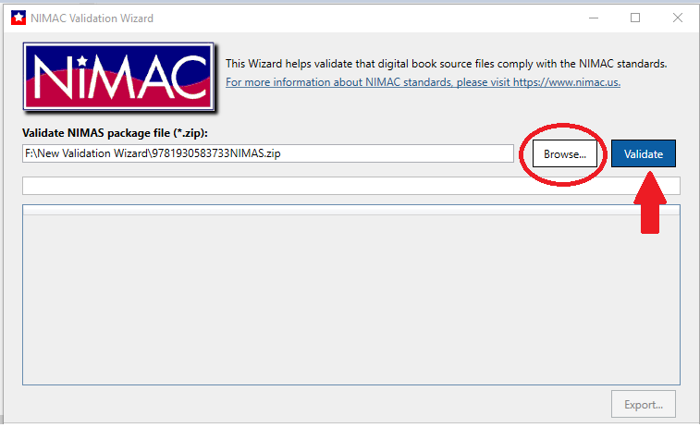
Navigation to the Zipped File

Slide 28
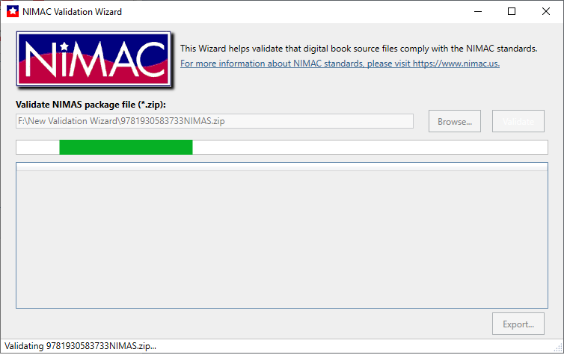
Validation in Progress . . .

Slide 29
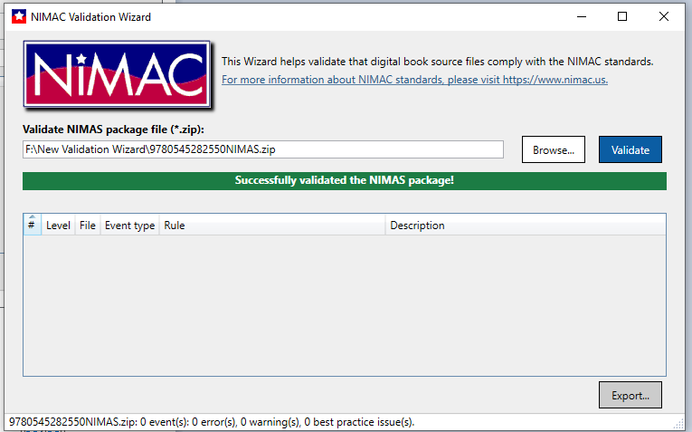
Successful Validation Output

Slide 30
Types of Validation Output
Errors: Must be corrected or file cannot be uploaded to NIMAC system.
Warnings: Correction is recommended but not required.
Best Practice: Information to consider in preparing NIMAS files.

Slide 31
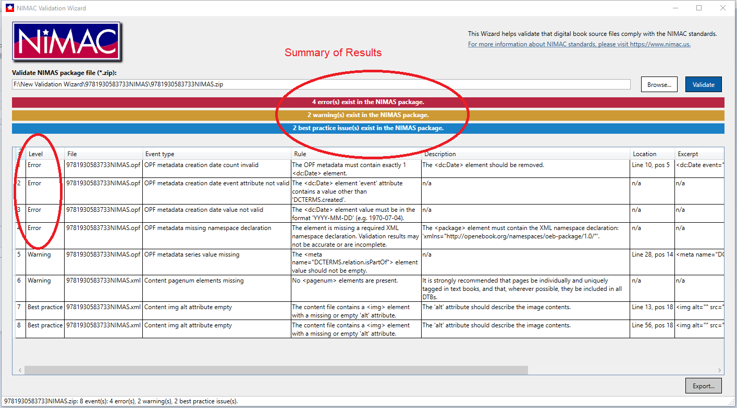
Validation Output Showing Errors

Slide 32
Corrupt Zip Files
Occasionally files will fail upload or batch processing due to the zip files being corrupt.
After zipping your NIMAS file sets, it’s a good idea to check to ensure that the files were not corrupted during the compression process.
Just click on the zip file. If it opens, the file is probably okay and not corrupt.

Slide 33
File Submission Part 2:
File Delivery Procedures

Slide 34
Manual File Upload
Files up to 300MB each can be manually uploaded to the NIMAC system by logging into your publisher or vendor account.
When you log into your account, your inventory will always be your landing page.
“Add Inventory” is used to manually upload a file for an ISBN not already in the system.
“Replace Zip File” is used to upload a file and replace the existing file.

Slide 35
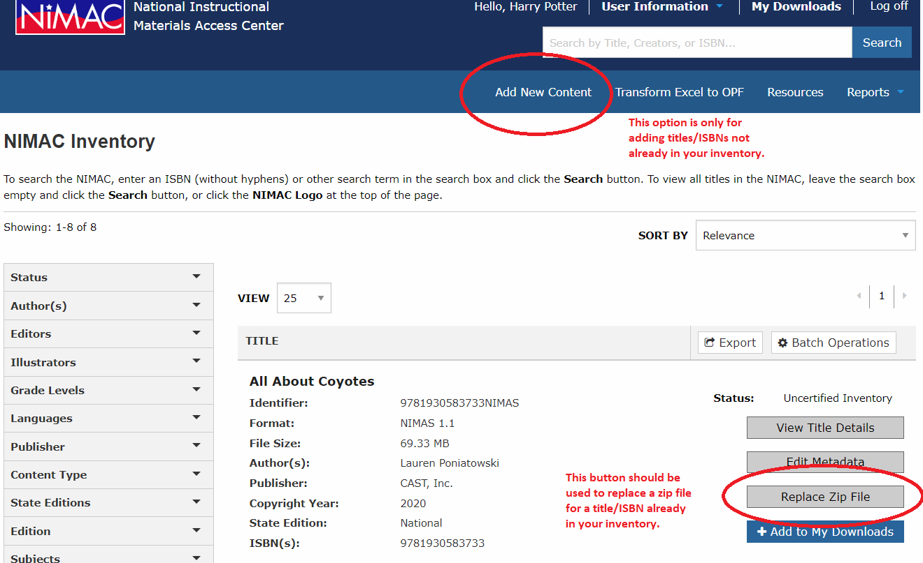
Add New Content vs. Replace Zip File

Slide 36
Manual Upload Process
When files are uploaded, the file first undergoes automated validation.
If the file fails, the system will show a detailed message regarding the problem(s).
If the file passes, the system will extract the metadata from the OPF for the file and open it on a page where it can be reviewed, edited and then saved.
Once the file is saved, it will appear in your Uncertified inventory.

Slide 37
Manual Upload vs. Batch Delivery
Files up to 300MB each can be manually uploaded to the NIMAC system, but the upload time will be slower the larger the file is.
Due to upload times, you may want to consider delivering files over 250MB each by FTP.
There is no minimum or maximum file size for submitting files by FTP.
There is also no minimum or maximum number of files that can be delivered at one time.

Slide 38
Batch Delivery (FTP)

Slide 39
Delivering files by FTP
Files that are over 300 MB must be delivered directly to our system vendor, OverDrive, by SFTP.
The host location of the FTP is:
transfer.overdrive.com
If you do not yet have an FTP login, you can request one by emailing OverDrive:
nimac-support@overdrive.com

Slide 40
Requesting FTP Access
In your request, include your NIMAC login ID for the publisher’s account.
If you are a publisher, you will need to create a NIMAC “sub user” account for each conversion vendor that needs to upload files on your behalf.
If you are vendor, you will need a separate FTP login for each publisher account that you work with.

Slide 41
Important Note: Don’t deliver NIMAS files inside folders
When placing files on the FTP, put them in the ROOT directory of the FTP only.
Do not use folders or subfolders on the FTP.
The automated batch process cannot detect files that are delivered inside folders.
If you have questions or need any further assistance, just let us know.

Slide 42
The Daily Batch Delivery Report

Slide 43
Batch Delivery Report
FTP deliveries are processed overnight.
The next morning, you will receive an automated report that details the processing results.
This report will go to the email address associated with the FTP login.
If you are a vendor that supplies files for multiple publishers, you will receive a separate report for each publisher.

Slide 44
Side Note: Junk/Spam filters
If you are delivering files by FTP but are not seeing the automated email the following morning in your Inbox, please be sure to check your Junk folder.
You may need to whitelist noreply-NIMAC@overdrive.com or the domain overdrive.com in order to successfully receive the emails.

Slide 45
Reviewing the FTP Report
Please be sure to review all reports you receive.
The daily report is your only notification if an FTP delivery fails.
Note: If the email address associated with the user who set up the FTP account changes (or if that user leaves the company), you will need to notify OverDrive so they can either update the FTP account or create a new one.

Slide 46
Reading the Report
At the top of the report, you will see a summary of the upload results:
If the report shows no failed uploads, you do not need to take any further action.
If the report does show failed uploads, please review the Details column information, correct the issue, and deliver the file again.

Slide 47
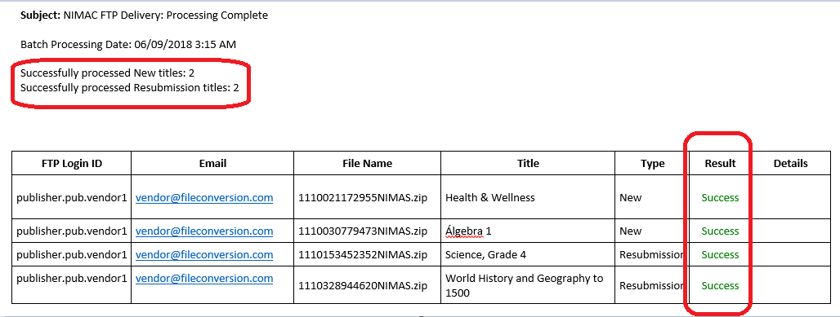
Report showing all uploads successful

Slide 48
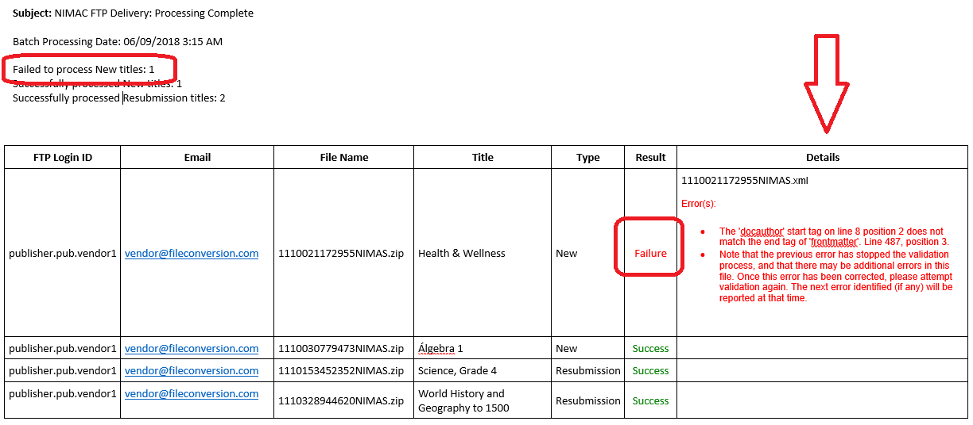
Report including failed upload

Slide 49
Failed uploads
If a delivery fails, the Details column in the daily report will provide the information related to the error that prevented upload.
The daily report is your official notification regarding failed uploads.
If you have any questions about an error on a report, contact the NIMAC.

Slide 50
Uploading Corrected Files
Once you have corrected and resubmitted a file, you do not need to provide any notification to OverDrive or NIMAC.
Just deliver the file(s) again by FTP.
The new delivery will show up on the daily report on the following day.
You will be able to verify at that point that the corrected file uploaded successfully.

Slide 51
Resubmission of Certified Inventory
If a file has already been certified, the system will prevent a replacement file from being saved to overwrite it.
If you need to intentionally resubmit a file that is in Certified status, just contact us and we can move the file into Stalled so it can be replaced.

Slide 52
File Review & Certification

Slide 53
NIMAC File Review
Newly uploaded files automatically appear in Uncertified inventory and are placed in the file review queue.
Files are generally reviewed in the order received but we are happy to expedite files when there is an immediate need.
If there are any issues identified in the file review, we will contact you with any questions or feedback.

Slide 54
Certification
To be accepted into the NIMAC, files must pass the automated validation (upon upload) and a manual quality check by NIMAC staff.
When files are certified, they appear in your Certified inventory and the “super user” receives an automated email with the digital certificate number.
You can also add up to three additional email addresses to receive these emails.
The numbers will also be shown in any inventory report you export from the system.

Slide 55
File Review Checks
NIMAC staff review the metadata submitted with the file set to ensure it is correct and complete.
There are some additional checks to the XML to ensure that some required tags are present and that common elements like the TOC and glossary are tagged correctly.
We will also make a cursory review of alt text.
NIMAC does not receive print books and does not do a page-by-page comparison to evaluate the tagging in the XML.

Slide 56
File Feedback
NIMAC staff can make minor metadata corrections in the system at the point of file review without requiring that files be resubmitted.
However, problems in the XML or PDF require vendor correction and resubmission of the file.
Detailed feedback will be sent to the person who delivered or uploaded the file if this happens.
These files are placed in “Stalled” inventory while we await the corrected file.

Slide 57
File Review Timeline
The time for a delivery to be reviewed and certified varies depending on the number of files received at a given time and the number of files in the review queue.
During times of light submissions, a file may be certified the day it is uploaded to the system.
If a delivery is large or many other files are in the queue, it may take 1-2 weeks or longer.

Slide 58
Certification Deadlines
Please let us know at the point of file submission if you have a deadline with a customer.
We encourage you to submit files at least two weeks in advance of a deadline.
This helps ensure that if there are any issues, your vendor will have time to make the needed corrections.
Files are usually certified in the order received, but we are happy to prioritize files to help a publisher meet a deadline.

Slide 59
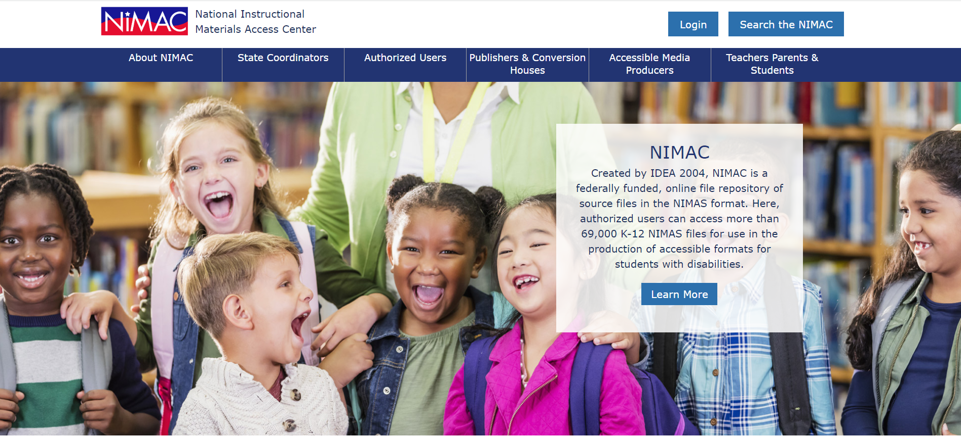
NIMAC Homepage

Slide 60
Live Demo

Slide 61
Questions?
For any questions about the status of files in the NIMAC system, feedback provided by our staff, or anything else, don’t hesitate to get in touch:
nimac@aph.org
877-526-4622
The contents of this resource was developed under a grant from the US Department of Education, #H327E210001. However, these contents do not necessarily represent the policy of the US Department of Education, and the reader should not assume endorsement by the Federal Government. Project Officer: Rebecca Sheffield.

