Slide 1

NIMAS & Braille 2000: Leveraging Files for Math . . . And More!
Liz Schaller
NIMAC Manager
eschaller@aph.org
Rosemary Baggott
Transcriber, Rhyomai, Inc.
rhyomai.inc@gmail.com

Slide 2
Today’s Workshop
Part 1: Introduction to the NIMAC
  NIMAC Background
  How to work with the NIMAC
Part 2: MathML in NIMAS
  What is MathML?
  Some examples!
  How to download files with MathML
Part 3: Transcribing with MathML
  Working with BrailleBlaster
  Working with Braille 2000
Part 4: Q&A

Slide 3
NIMAC: Background and Basics

Slide 4
The NIMAC Project
  Created by IDEA 2004, the NIMAC is the national source file repository for K-12 textbooks and instructional materials.
  We make NIMAS files available for use in producing accessible formats for K-12 instructional materials.
  We have over 74,500 file sets from over 180 educational publishers.
  All 50 states (plus the 6 eligible territories) work with the NIMAC.

Slide 5
What is NIMAS?
  NIMAS is the National Instructional Materials Accessibility Standard.
  An XML-based source file format established for the sole purpose of use in producing accessible formats such as braille, DAISY, EPUB, or large print.
  NIMAS files require further conversion work into an accessible format before use.
  NIMAS is not distributed directly to students.

Slide 6
NIMAS Production
NIMAS is not a “by-product” of print or digital book production, so NIMAS is not a format that publishers have on hand.
NIMAS must be separately created after print books are finalized.
Publishers do not produce their own NIMAS files—they outsource this work to digital content conversion vendors.
It can take up to six weeks or more for NIMAS to be produced.

Slide 7
How we get files
  Under IDEA 2004, the only mechanism to require NIMAS from the publisher is the book adoption contract or purchase agreement.
  There is no blanket requirement under IDEA for publishers to submit files to the NIMAC.
  States and districts have been able to require NIMAS when they purchase new textbooks since 2006.
  The goal is that when NIMAS is included in contracts, a file will already be available in the NIMAC when a need is identified.

Slide 8
Types of materials we receive
  NIMAC receives a wide range of student-facing instructional materials.
  These include textbooks, workbooks, supplementary readers, and ancillary materials such as blackline masters.
  Exempt materials include teacher’s editions, pre-2006 titles, trade books, college textbooks, reference books.
  We can also now accept NIMAS files for some digital instructional materials.

Slide 9
Student Eligibility
Materials produced from NIMAS can only be distributed to qualifying students in elementary or secondary education.
Students must have both:
  An Individualized Education Program (IEP); and
  A certified disability under the NLS Eligibility Guidelines.
NIMAS is not available for use on behalf of students outside of the U.S. or the eligible territories.

Slide 10
College Students
NIMAS is not available for use on behalf of students in higher education.
However, the AccessText Network is a program that helps provide accessible files to students in higher education.
AccessText works through DSS offices at colleges and universities.

Slide 11
How the NIMAC works with states
Each state that agrees to work with the NIMAC names a State Coordinator.
This individual is responsible for designating Authorized Users (AUs) for the state.
Since NIMAS is not distributed directly to schools or students, the number of Authorized Users for each state is small.
AUs are from within the educational structure of the state. They are involved in or manage accessible format production for K-12 students in that state.

Slide 12
What can AMPs do?
AMPs cannot directly search and download any file from the repository.
An AMP account allows the user to download any file assigned to them by an Authorized User.
AMP accounts are freely available to nonprofit and for-profit providers.
These users do not have to be designated by a State Coordinator, and they can do work on behalf of any state.

Slide 13
Registering as an AMP
To begin an AMP registration, email nimac@aph.org with your name, email address and organization name.
We will enter the registration in the system, and you’ll receive an automated email with a link to complete the registration.
Be sure to complete all the registration information, including your format capabilities.
If you produce a format not on the pick list of options, just choose “Other” to indicate this.

Slide 14
Working with AUs
Once you have an active AMP account, any Authorized User in any state can assign you files for download.
The NIMAC itself is not involved in any business arrangements between states/districts and AMPs.
If you are working on a project for a state or district and need help locating an AU in that state to assign you the NIMAS file, just let us know.

Slide 15
MathML in NIMAS

Slide 16
MathML and NIMAS
MathML is optional XML markup for math and scientific notation.
The benefit of MathML is that, when software supports it, it can be used to automatically generate braille or other formats.
In the past, math was most often provided in NIMAS as images, which cannot automatically be converted into braille.

Slide 17
Downloading Files with or without MathML
Many publishers now provide MathML in their NIMAS files--however, not all software supports MathML.
If a NIMAS file includes MathML, but your software does not support MathML, you can choose to download the file without MathML.

Slide 18

Download Options in the System

Slide 19
Fallback Images
The No MathML download will instead include the images for the math expressions. These images can be used to aid in transcription and tactile graphic production.

Slide 20
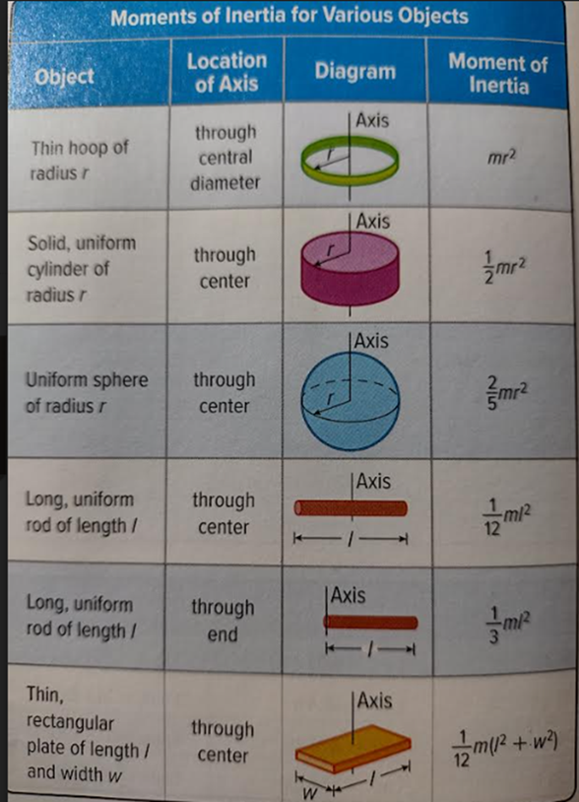
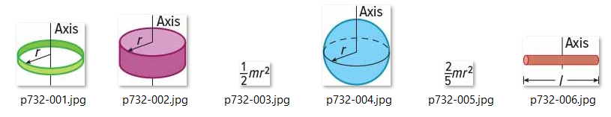
Example of Fallback Images
Other Math Images:
Inspire Physics page 732

Slide 21
Math as “Regular Text”
Important: Sometimes, math expressions may be provided as regular text within files that do contain MathML. Rosemary will discuss the implications of this for your transcription work in the next section.

Slide 22


Example of Regular Text Math in NIMAS File with MathML
<td id="BM03.UT07.TD06" valign="top" align="left">Thin hoop of radius <em>r</em></td>
<td id="BM03.UT07.TD09" valign="top" align="center"><em>mr</em><sup>2</sup></td>
<td id="BM03.UT07.TD10" valign="top" align="left">Solid, uniform cylinder of radius <em>r</em></td>
<td id="BM03.UT07.TD13" valign="top" align="center"><m:math display="inline" id="math-971" altimg="./images/BM/p732-003.jpg" xmlns:dtbook="http://www.daisy.org/z3986/2005/dtbook/" alttext=""><m:mrow><m:mfrac><m:mn>1</m:mn><m:mn>2</m:mn></m:mfrac><m:mi>m</m:mi><m:msup><m:mi>r</m:mi><m:mn>2</m:mn></m:msup></m:mrow></m:math></td></tr>
Inspire Physics page 732

Slide 23
MathML Tagging in XML
As seen in the previous slide, MathML tagging in XML files is easy to spot, but not necessarily human readable. If you aren’t sure if your file has MathML tagging, you can take a look at the declaration at the very top of the file.
You can quickly find MathML expressions in your file by searching for the m:math tag.

Slide 24
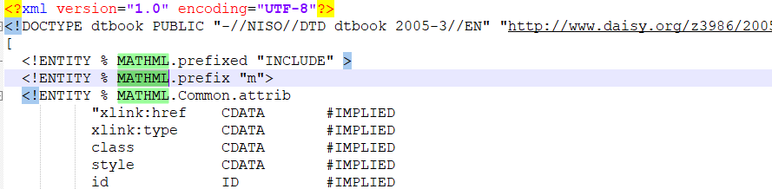
MathML Tagging in XML (continued)
<m:math display="inline" id="math-09" altimg="./images/U00/p012-004.jpg" xmlns:dtbook="http://www.daisy.org/z3986/2005/dtbook/" alttext=""><m:mrow><m:mfrac><m:mrow><m:mn>409.2</m:mn><m:mtext>&#x2009;</m:mtext><m:mtext>km</m:mtext></m:mrow><m:mrow><m:mn>11.4</m:mn><m:mtext>&#x2009;</m:mtext><m:mtext>L</m:mtext></m:mrow></m:mfrac><m:mo>&#x003D;</m:mo><m:mfrac><m:mrow><m:mn>35.9</m:mn><m:mtext>&#x2009;</m:mtext><m:mtext>km</m:mtext></m:mrow><m:mtext>L</m:mtext></m:mfrac></m:mrow></m:math>

Slide 25
Transcribing with MathML

Slide 26
What We’ll Cover
Workflow for opening NIMAS files with MathML in BrailleBlaster
Identifying MathML in BrailleBlaster
What to watch out for in translations
Editing MathML translations for UEB and Nemeth
Examples!!
Using BrailleBlaster translation in your braille software AND new support for MathML in Braille 2000

Slide 27
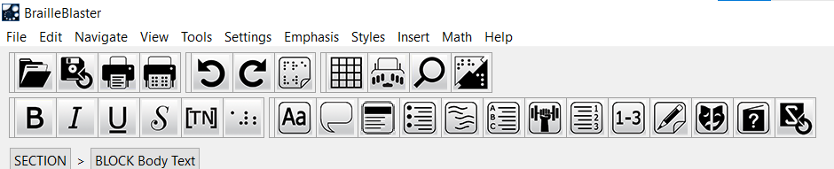
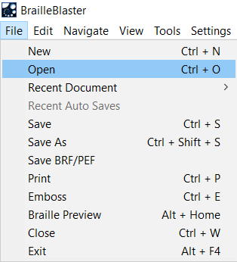
Opening NIMAS with MathML in BrailleBlaster
In BB Control panel, select File → Open
Notes:
In this presentation, we’ll look at opening NIMAS with MathML with two different programs.
First, opening in BrailleBlaster befoe transferring to Braille 2000.
*”Once you’ve opened the NIMAS file in BrailleBlaster,…

Slide 28
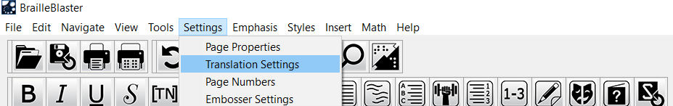
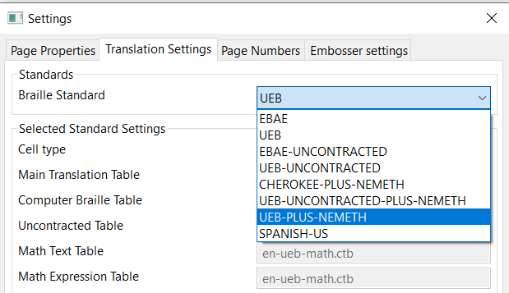
Opening NIMAS with MathML in BrailleBlaster (continued)
After opening xml file, select options in BB tool bar.
Settings → Translation → (select)
Notes:
*you’ll want to make a few full file edits before saving In Braille 2000.
*Some of the options I’ve found helpful: Translation Settings and Emphasis
Possible Translation Setting options are shown here, in the drop-down menu.” (READ SLIDE INFO)

Slide 29
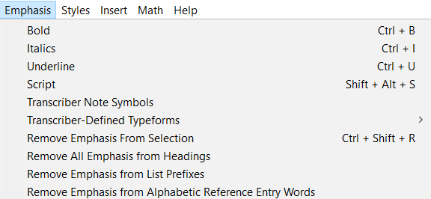
Opening NIMAS with MathML in BrailleBlaster (continued)
After opening xml file, select options
Emphasis → select options to “Remove Emphasis”
Notes:
*Another helpful tool is Emphasis.
*Selecting Emphasis settings before saving file to your transcription program can ultimately save transcription time.
(READ SLIDE INFO.)

Slide 30
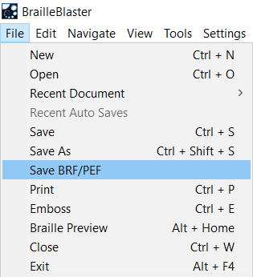
Opening NIMAS with MathML in BrailleBlaster (continued)
File → Save BRF (Otherwise, BB creates a bbx file.)
Resave within your transcription program.
Notes:
*Once you’ve selected your settings, you can save it as a brf file, which will open in Braille 2000.
BrailleBlaster will prompt you with where in your system to save the file. Then you can go into your files and Open the file. It should open in Braille 2000. Follow the prompts in B2000 to open in whichever translation you need. (UEB, etc.)
QUESTIONS?

Slide 31


How to Identify MathML in BrailleBlaster
Search for page number in BrailleBlaster file.
(Control G) →
Enter print page number →
Select “Go to”
Notes:
Back in the BrailleBlaster program, we’ll take a look at what MathML notation looks like. If you’re searching, as I prefer to do, from the
print book, you can first find the print page in question by entering (READ SLIDE).
We’ll look at the print page, the BrailleBlaster print view, and the BrailleBlaster braille view.

Slide 32
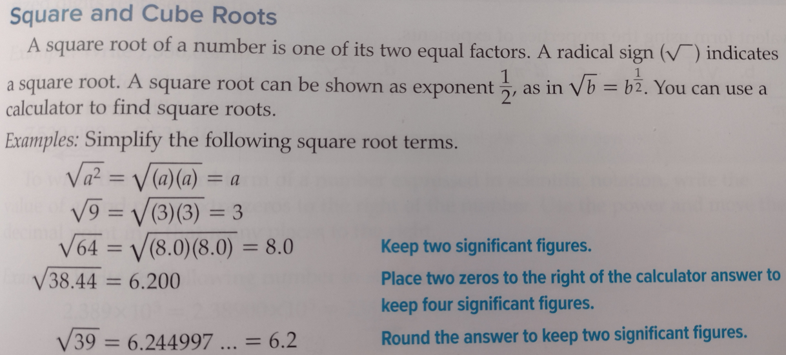
How to Identify MathML in BrailleBlaster (continued)
Inspire Physics page 711, print page
MathML-tagged material boxed in red
translated
null
Notes:
*Print page 711 from Inspire Physics.
*Some of the MathML-tagged material has been translated into braille by BB.
(EXPLAIN FROM SLIDE)

Slide 33
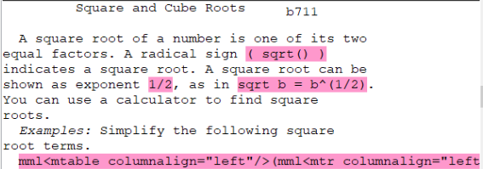
How to Identify MathML in BrailleBlaster (continued)
BrailleBlaster print view: pink highlighting
Note differences between print and ASCII.
Note use of word “null” when MathML is not translated
translated
null
Inspire Physics page 711
Notes:
*BrailleBlaster print view (depending on version) uses print highlighting to help locate MathML tagged expressions.
*Go back one slide to show differences between print view and ASCII translation of xml—for embedded math and for isolated
expression (not translated in this book)
Emphasize that print text, NOT BB print, is final guide to transcription.

Slide 34
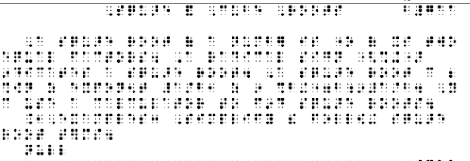
How to Identify MathML in BrailleBlaster (continued)
UEB Braille Translation
Either it’s there or it’s not; see both examples below.
Note: Use of the word “null” when item is not translated
translated
null
Inspire Physics page 711
Notes:
*Braille view in BrailleBlaster is to the right of the print view (shown in previous slide).
(Go back two slides to show print text view; compare with braille view here.)
*This is the UEB translation.

Slide 35
Opening NIMAS with MathML in BrailleBlaster (continued)
After opening xml file, select options in BB tool bar.
Settings → Translation → (select)
Notes:
*You can switch the braille translation WITHIN BRAILLEBLASTER by selecting from Translation setting in the toolbar.
*So, if I want to see the UEB with Nemeth translation, I select it, click OK, and wait for BB to convert it. (next slide)

Slide 36
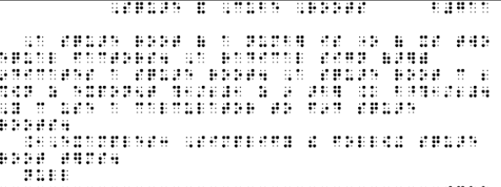
How to Identify MathML in BrailleBlaster (continued)
UEB with Nemeth Translation
Need for transcriber editing
Nemeth switch indicators; punctuation adjustments
translated
null
Inspire Physics page 711
Notes:
*Here’s the UEB with Nemeth translation of the same passage. *The most common transcriber edits needed are insertion of Nemeth switch indicators and occasional punctuation adjustments.
*Punctuation adjustments can be dot 6 comma, or punctuation indicators. (SHOWN ON NEXT SLIDE)

Slide 37


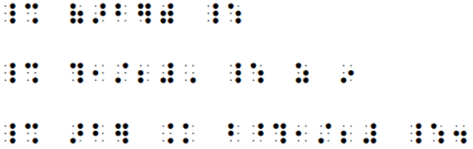
Editing MathML in Nemeth Transcription from BrailleBlaster
Print view, Inspire Physics, page 711 MathML
BrailleBlaster UEB with Nemeth Translation
Transcriber edited:
OR
Notes:
“This shows the UEB with Nemeth translation, and transcriber edits, including Nemeth switch indicators.
*1st example: Nemeth switch indicators (USE MOUSE TO RELATE CONNECT MATH TO TRANSLATION BELOW.)
*2nd example: Switch indicators AND use of Nemeth comma,
*3rd example: Switch indicators and relocation of final period to FOLLOW the closing switch indicator. NOTE: If this expression were followed by another math expression in the text, you would use the punctuation indicator before the period, as shown in the 4th example.

Slide 38
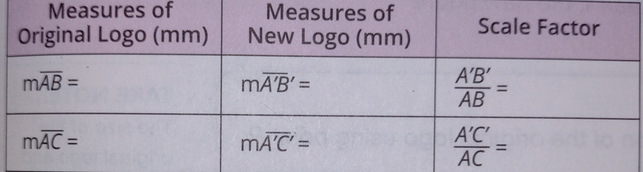
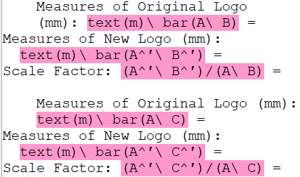
Editing MathML in UEB Transcription
MATHbook Course 3, page 88, print text
BrailleBlaster print view (BB chooses list format for table.)
NOTE: The = signs were apparently not tagged as MathML, so remain in regular UEB. Transcriber needs to edit in Nemeth.
Notes:
*Another example, showing print text and BB print views—MathML in table. HORIZONTAL BAR MODIFIER, AND PRIME SIGN.
*NOTE: (READ SLIDE INFO)
*Now let’s look at the UEB and Nemeth braille translations.

Slide 39
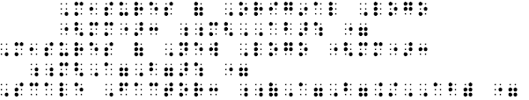
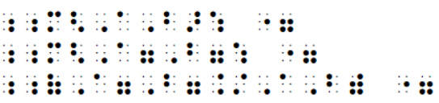
Editing MathML in UEB Transcription (continued)
MATHbook Course 3, page 88, print text
UEB Translation (first entry only is shown; all were translated in BB)
Transcriber Editing of Math expressions
Notes:
*UEB translation is basically accurate, though it’s preferable to use individual capital indicators before each letter, for the sake of consistency.
(or depending on transcriber choice.) (USE MOUSE TO POINT, CONNECT.)
*NOTE: The omission of the equals sign from MathML tagging is not a problem in UEB translation.

Slide 40
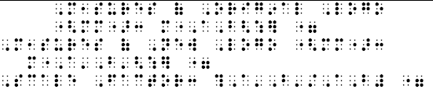
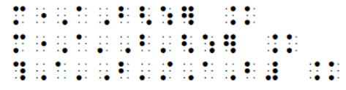
Editing MathML in UEB with Nemeth Transcription
MATHbook Course 3, page 88, print text
UEB With Nemeth Translation
Transcriber Editing
Notes:
*The Nemeth example shows the need for transcriber editing of equals sign that was not converted into MathML..
* Nemeth switch indicators will need to inserted by the transcriber, depending on how you choose to format the table.

Slide 41
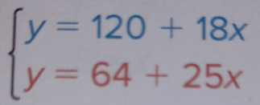

Spatial Arrangements in MathML
MATHbook Course 3, page 321, print text
UEB With Nemeth Translation in BrailleBlaster
Transcriber Editing
Notes:
* Spatial arrangement (System of Equations) with MathML tagging. NOTE: STRANGE SYMBOL BETWEEN LINES.
*The Nemeth example shows the need for transcriber editing of equals sign that was not converted into MathL..
* Nemeth switch indicators will need to inserted by the transcriber, depending on how you choose to format the table.

Slide 42

Spatial Arrangements in MathML
MATHbook Course 3, page 321, print text
UEB in BrailleBlaster
Transcriber Editing

Slide 43

Example of both MathML, “Regular Text” and graphics in a table
Inspire Physics page732
Transcriber’s perspective
Outlined items tagged as MathML
Need to edit first item, NOT tagged
Use MathML-tagged expressions within your formatting
Notes:
Explain need to edit first table entry, since the level indicators are not yet recognized in BB, and haven’t been tagged as MathML.

Slide 44



Math as “Regular Text” Translation
Editing “math as regular text” in table
BrailleBlaster braille view
UEB Translation
UEB with Nemeth
Inspire Physics, page 732, (continued)

Slide 45
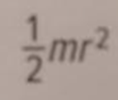








Editing MathML for Transcription in a Table
Print text | UEB Translation | UEB with Nemeth
Inspire Physics page 732
Notes:
*These MathML tagged expre4ssions were accurately converted.
* Nemeth expressions will need switch indicators inserted by transcriber.

Slide 46



Editing MathML for Transcription in a Table (continued)
Print text:
UEB with Nemeth:
UEB:
Transcriber edit:
Inspire Physics, page 732, (continued)
Notes:
LIZ, THE INFORMATION ON THIS SLIDE NEEDS TO REPLACE THAT ON

Slide 47
NIMAS Formatting of Table Entry
Inspire Physics page732
Transcriber’s perspective
Single entry in table formatting
Use MathML-tagged expressions and graphics within your formatting
Notes:
Looking again at this table, to see how one item was formatted on a graphics page.

Slide 48
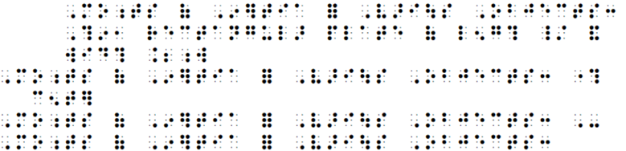
Locating and Editing MathML for Transcription
Inspire Physics, page732
NIMAS table formatting for one entry shown below
Transcriber-edited UEB math expression, from MathML
Notes:
Show NIMAS set up for one of the table entries

Slide 49
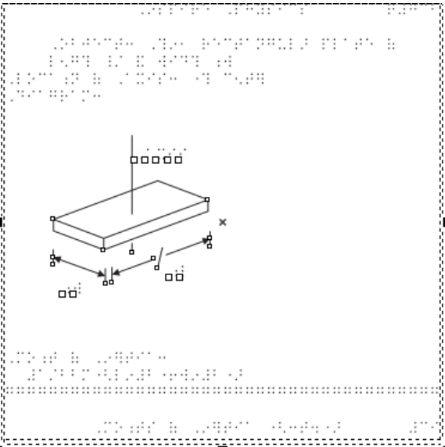
Completed Transcription for Inspire Physics, page 732
Notes:
*Here’s an example of one entry, including the graphic (drawn in graphics program, using NIMAS Image file that Liz showed earlier),
And the MathML-tagged expression translated into UEB Technical. (present in the braille translation)

Slide 50
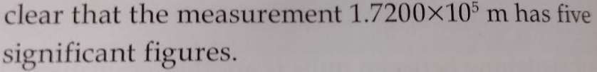
Another Example of Math as Regular Text
Inspire Physics, page 12
UEB level indicators not shown
Needs transcriber entry in Nemeth
BrailleBlaster print view
BrailleBlaster UEB Translation
Transcriber edited
Notes:
OPTIONAL: *NOTE: Need for close attention of the transcriber, since the translation might “appear” okay. Follow print text.

Slide 51
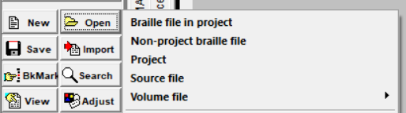
Opening NIMAS with MathML in Braille 2000
In Braille 2000 tool bar, click on Open → Source File → Select xml file from your computer
→ Select xml file from your computer.
Notes:
*NIMAS files can also be directly imported into Braille 2000.
*Braille 2000 Version 3, still in beta stage, will recognize and translate much of MathML.
*Formatting may be different from what is imported by BralleBlaster. (Liz?)

Slide 52
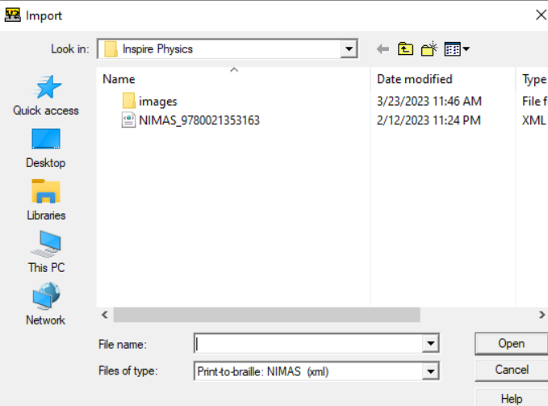
Opening NIMAS with MathML in Braille 2000
→ Select xml file from your computer.

Slide 53
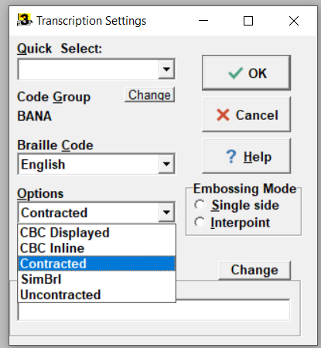
Opening NIMAS with MathML in Braille 2000 (continued)
Select Transcription Settings pop-up box; OK
EBAE
Notes:
*Check transcription settings to be sure they correspond to the project specs. In this case, the default, on opening, was set to EBAE.

Slide 54
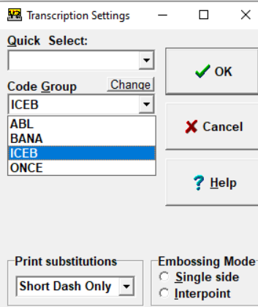
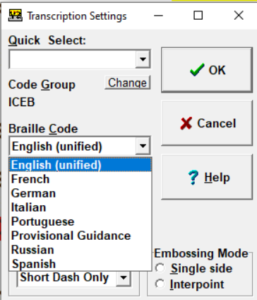
Opening NIMAS with MathML in Braille 2000 (continued)
Select Transcription Settings pop-up box; OK
UEB
Notes:
*To change to another setting, click on “Change” and select from the dropdown menu.
*Use ICEB to locate UEB (Englsh (unified))

Slide 55
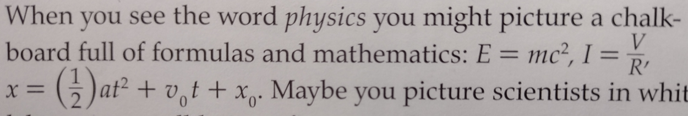
Opening NIMAS with MathML in Braille 2000 (continued)
Braille 2000 Version 3 (beta) MathML translation
Goal is to translate all of MathML in both UEB and Nemeth
Let’s look at some examples!
Inspire Physics, page 4
Notes:
Liz: *(mention developers: BB, Braille 2000)
*Braille 2000 Version 3, currently in beta stage, is intended to open and translate all MathML in a NIMAS file.
*At present, my observation is that Braille 2000 is catching the level change indicators, but still working on spacing and fractions.

Slide 56
Transcriber User Groups
If you haven’t already, please consider joining our Duxbury or Braille 2000 User Groups for transcribers who work with NIMAS!
The groups are:
  Relatively informal;
  Facilitated by a skilled transcriber;
  Convened quarterly on Zoom; and
  An opportunity for transcribers to connect and share information and pointers on textbook transcription.
Please let us know by emailing us at nimac@aph.org if you are interested in participating.

Slide 57
Q & A
For any questions about how to use NIMAC or the status of files in the NIMAC system please contact us for assistance:
nimac@aph.org
877-526-4622
The content of this resource was developed under a grant from the US Department of Education, #H327E210001. However, these contents do not necessarily represent the policy of the US Department of Education, and the reader should not assume endorsement by the Federal Government. Project Officer: Rebecca Sheffield.

