Slide 1
The NIMAC & Louis
Supporting Students and Teachers

Slide 2
Nicole gaines
National Director of Digital Access Initiatives (ngaines@aph.org)
Liz Schaller
NIMAC Manager (eschaller@aph.org)
Notes:
Open:

Slide 3

The NIMAC:
Bridging the Accessibility Gap since 2006

Slide 4

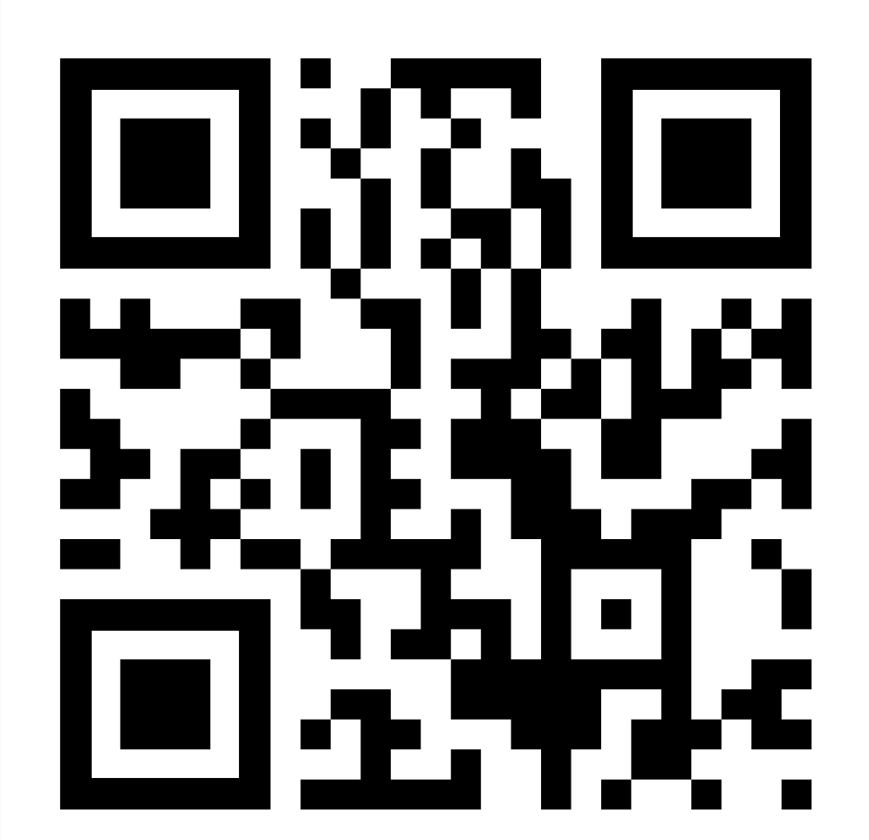
The NIMAC Informational Website

Slide 5
The NIMAC Project
Created by IDEA 2004, the NIMAC is the national source file repository for K-12 textbooks and instructional materials.
We make NIMAS files available for use in producing accessible formats for K-12 instructional materials.
We have received over 74,500 file sets from 185 educational publishers.
All 50 states plus the 6 eligible outlying areas and the DoDEA work with the NIMAC.
NIMAC users have downloaded over 52,000 files from the repository.

Slide 6
NIMAC Files and AEM Production
The NIMAC receives files in the “NIMAS” format.
Under IDEA, this is the only format we can accept.
NIMAS is a source file format—this means it is not directly usable by students but is intended to be transformed into another format.
NIMAS is not distributed directly to students.
Files are used to create a range of formats, including:
  braille
  large print
  digital formats (e.g., DAISY, EPUB)

Slide 7
The NIMAC and States
IDEA 2004 does not require that states work with the NIMAC, but all states have chosen to do so.
States that coordinate agree to:
  Require NIMAS from publishers in their textbook procurement contracts
  Abide by the eligibility requirements of IDEA and copyright law in the use of NIMAS and distribution of materials produced from the files
Each state has a State Coordinator who designates the Authorized Users of the NIMAC for the state.

Slide 8
Authorized Users and Accessible
Media Producers
Authorized Users (AUs) that are designated by states can log in and download NIMAS files for use in production of braille and other accessible formats.
Accessible Media Producer account holders (AMPs) do not have to be designated by a state; these accounts are freely available.
AMPs can be assigned files for download by any Authorized User in any state, but they do not have direct access to search and download files.

Slide 9
TVIs as Accessible Media Producers
While most accessible textbook production is done by agencies and organizations like APH and Bookshare, TVIs may sometimes need access to a NIMAS file to create braille “on the fly” or for only a small part of a book.
TVIs are welcome to register with the NIMAC if you have the software and capability to generate braille for students locally.
Just reach out to us at nimac@aph.org for more information or a registration link.

Slide 10
Bookshare for K-12 Students
Bookshare is non-profit program that provides digital formats like DAISY, EPUB, and BRF to individuals with visual impairments or print disabilities.
Through a grant from OSEP, Bookshare provides memberships to K-12 students free of charge.
Bookshare downloads files from the NIMAC to produce accessible formats for qualifying students.
If the NIMAC has a file for a book a student needs—but it is not yet found in the Bookshare collection—the teacher can request it through their Bookshare account.

Slide 11
The NIMAC:
Scope, Eligibility & Procurement

Slide 12
What is NIMAS?
NIMAS is the National Instructional Materials Accessibility Standard.
An XML-based source file format.
Designed for use in producing formats such as braille, DAISY, EPUB, large print.
It is not distributed directly to students.
Braille software programs that support NIMAS include: BrailleBlaster, Duxbury, and Braille 2000.
Large print can be particularly challenging to produce from NIMAS.

Slide 13
Types of materials we receive
NIMAC receives “textbooks and related printed core materials” published primarily for use in K-12 education.
We receive NIMAS for textbooks, workbooks, supplementary readers, and ancillary materials such as blackline masters.
Generally exempt are pre-2006 titles, trade books, college textbooks, teacher-created materials and OERs.
We can also now accept NIMAS files for some digital instructional materials.

Slide 14
Eligibility in IDEA 2004
In order for students to be eligible for NIMAS, IDEA 2004, Part D, Sec. 674 (e)(3)(A) imposes two requirements:
  The student must have an Individualized Education Program (IEP).
  The student must have a qualifying disability.
In February of 2021, the NLS updated its eligibility guidelines to align them with updated language in copyright that resulted from the Marrakesh Treaty Implementation Act.

Slide 15
How we get files
  Under IDEA 2004, there was and is no blanket requirement for publishers to send files to the NIMAC.
  The only mechanism to require NIMAS from a publisher is by including the requirement in an adoption contract or purchase agreement.
  NIMAC can and does request files on behalf of users, but this always involves a delay—sometimes up to one or two months (or more) to receive the file.
  Sample contract language can be found on the National AEM Center website.

Slide 16
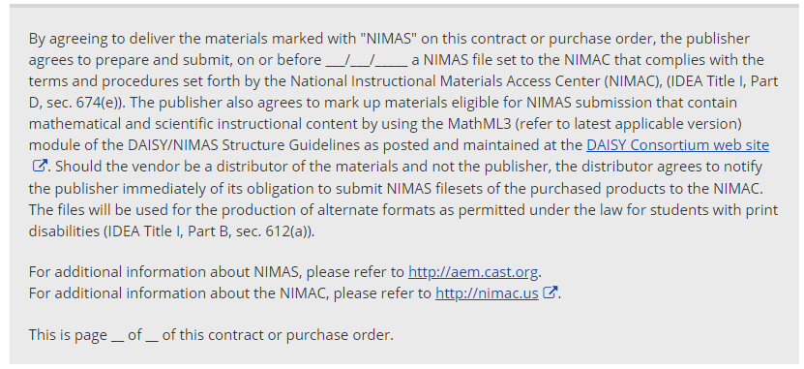
Sample Contract Language
In order for students to be eligible for NIMAS, IDEA 2004, Part D, Sec. 674 (e)(3)(A) imposes two requirements:
  The student must have an Individualized Education Program (IEP).
  The student must have a qualifying disability.
In February of 2021, the NLS updated its eligibility guidelines to align them with updated language in copyright that resulted from the Marrakesh Treaty Implementation Act.

Slide 17
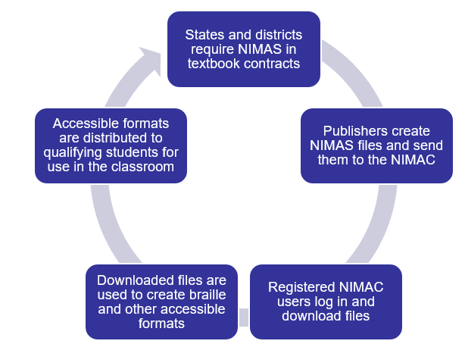
NIMAS Files and the AEM Ecosystem

Slide 18
Braille Transcriber Groups
The NIMAC now offers quarterly professional support for textbook transcribers.
There is a group for Duxbury users and another group for Braille 2000 users.
For more information or to get on the email list for meetings, just contact us at nimac@aph.org.

Slide 19
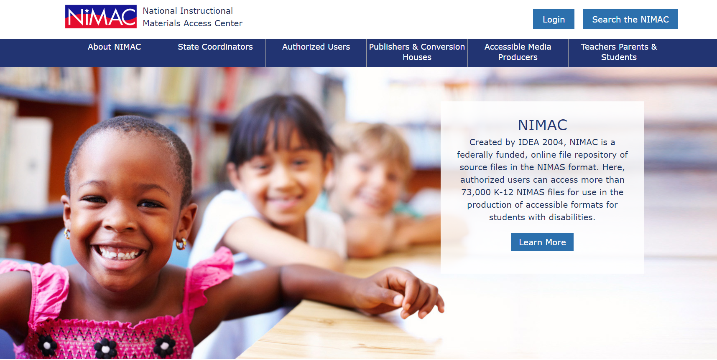
NIMAC Informational Website

Slide 20
Contact the NIMAC
Reach out at any time if you have questions or would like more information on becoming a NIMAC user:
    nimac@aph.org
    877-526-4622
    http://nimac.us

Slide 21
Louis & Related Services:
Supporting Timely Delivery to Students

Slide 22

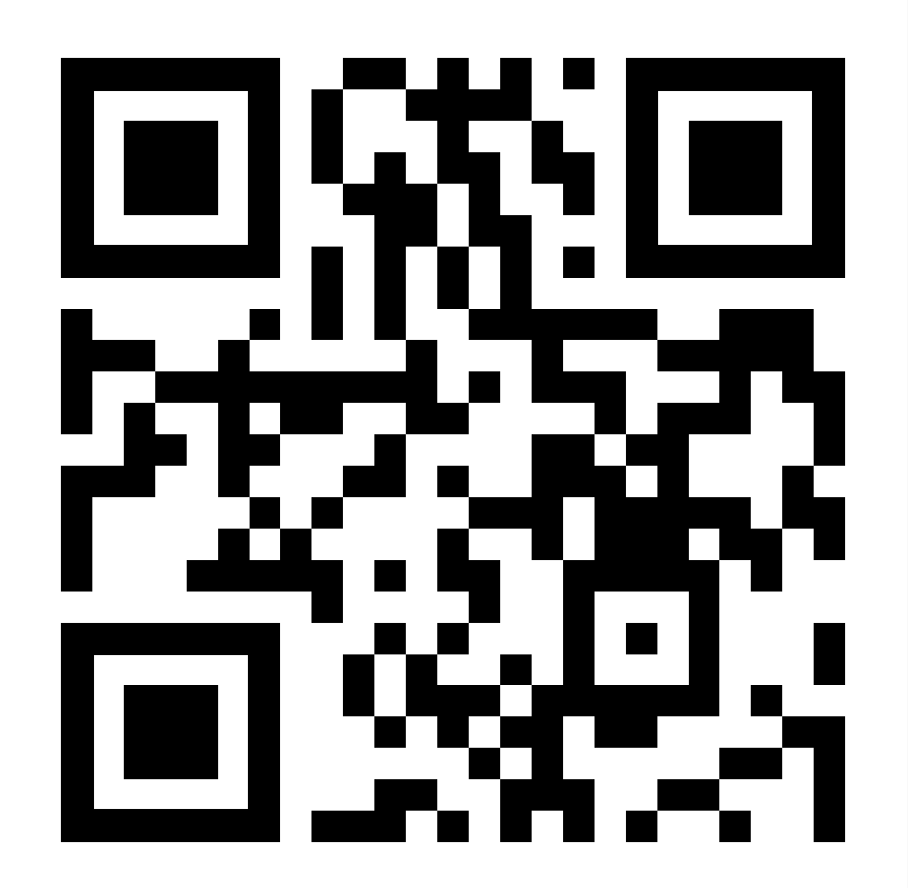
The Louis Website

Slide 23
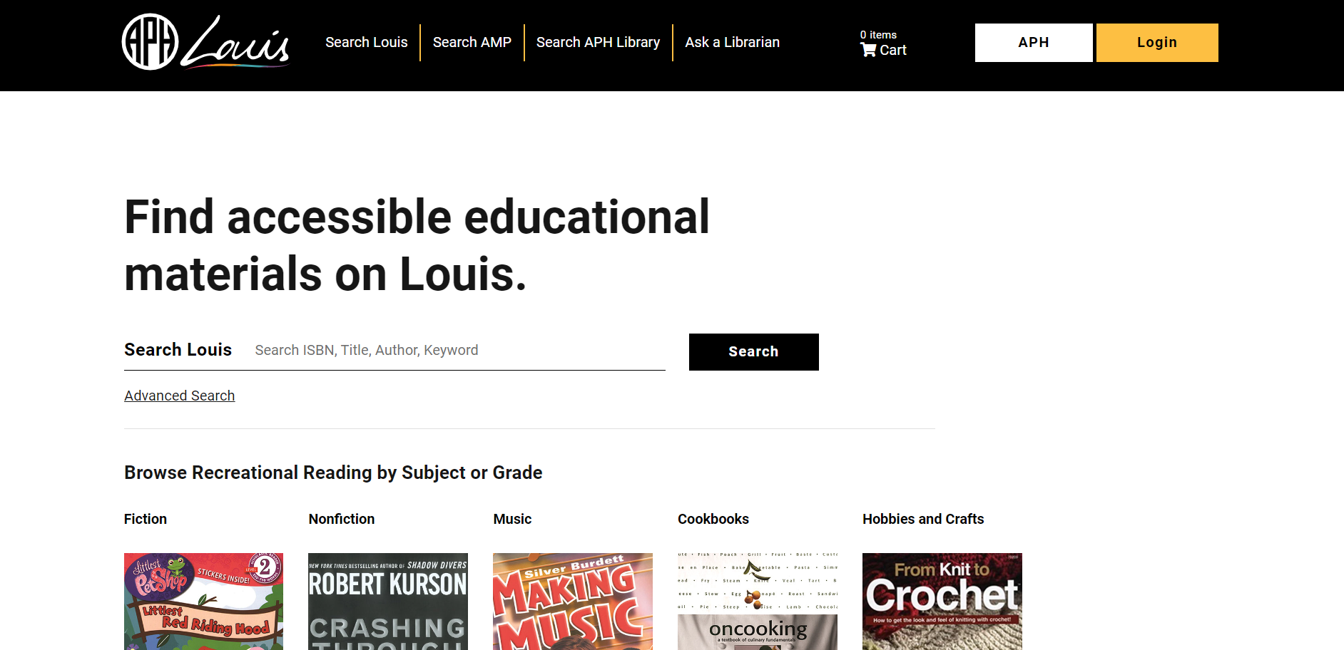
Louis Search Homepage

Slide 24
What is Louis?
Louis is a free service of APH that allows accessible media producers across the U.S. to list the materials they have available, so that teachers and others can easily locate these materials.
The goal of Louis is to support the timely delivery of materials to students – and avoid duplication of effort.
Louis includes information from over 60 organizations—including APH, Bookshare, and Learning Ally (and NIMAC).

Slide 25
Louis & NIMAC
While the NIMAC is a repository of source files for producing accessible materials, Louis is your first stop to find out if materials are already available.
We recommend checking Louis before placing a braille or large print order with APH or another organization.
Side note: Whenever APH receives a braille order, the first step it takes is to search Louis. APH will not accept a new braille order if embossed braille has already been produced by another agency.

Slide 26
APH Materials Found in Louis
APH textbooks are found in Louis:
  Embossed braille (including tactile graphics)
  Hard-copy large print
  Downloadable BRFs for APH braille books
  Tactile graphics packages (for use in conjunction with the downloadable APH BRF files)
  BrailleBlaster free “Braille on Demand” files
Other APH products are found in the APH ecommerce site (https://aph.org).

Slide 27
APH “Braille on Demand” Files
When a braille order is placed with APH, APH will create BrailleBlaster BRF files for use by the student, if needed, while awaiting the first braille volumes.
These are not fully formatted braille files, but they are higher quality than automated braille from Bookshare.
BrailleBlaster BRF can also be requested from APH outside of a braille order, but this is a somewhat convoluted process.
We are hoping to improve the workflow and make the service available directly to TVIs in 2024.

Slide 28
Additional Resources on Louis Site
Louis Database of Accessible Materials
  Provides information about 1.1 million accessible K-12 textbooks
Accessible Media Producers (AMP) Database
  Offers a mechanism for AMPs to list their services in a free searchable, national database
APH Library Catalog
  Supports APH staff with professional development materials
  Houses the Blind Musicians Collection (Spotify playlist)
  Contains the M.C. Migel Memorial Collection

Slide 29
BrailleBlaster: A free tool for TVIs
BrailleBlaster is free braille translation software that can be used by braille transcribers and others.
Input formats for BrailleBlaster include NIMAS, Word, HTML, TXT, EPUB and more.
Text can also be directly typed into the software to generate handouts or other documents.
For more information or to download the software, go to https://brailleblaster.org/

Slide 30
Contact Us!
For assistance with Louis, AMP, or the APH Library:
    resource@aph.org
    800-223-1839 x705
    https://louis.aph.org/#/
For assistance with the NIMAC:
    nimac@aph.org
    877-526-4622
    http://nimac.us
The contents of this resource was developed under a grant from the US Department of Education, #H327E210001. However, these contents do not necessarily represent the policy of the US Department of Education, and the reader should not assume endorsement by the Federal Government. Project Officer: Rebecca Sheffield.

