Slide 1

NIMAS File Validation: Using the NIMAC Validation Wizard

Slide 2
New Validation Wizard
In early 2022, the NIMAC released a new validation wizard for publishers and vendors.
This tool replaced the validation wizard that was developed in 2006.
This new level of file validation was also implemented into the NIMAC online system.
As in the past, we ask that publishers/vendors validate all files before submitting or uploading to the NIMAC.

Slide 3
NIMAS Validation
Files that fail automated validation will be rejected for upload by the system and in the batch delivery file processing.
Validating files before upload or delivery can help save you time later.
NIMAS validation has always ensured that the XML is well formed, that referenced images are present, and that the file validates to the NIMAS and MathML DTD (if MathML is present).

Slide 4
New Validation Wizard Features
The new tool provides a much more thorough examination of the NIMAS file.
In addition to the prior validation and file quality checks, the new tool also provides feedback related to missing or invalid OPF metadata.
It can also detect some XML tagging errors and provide Best Practices feedback for some issues.

Slide 5
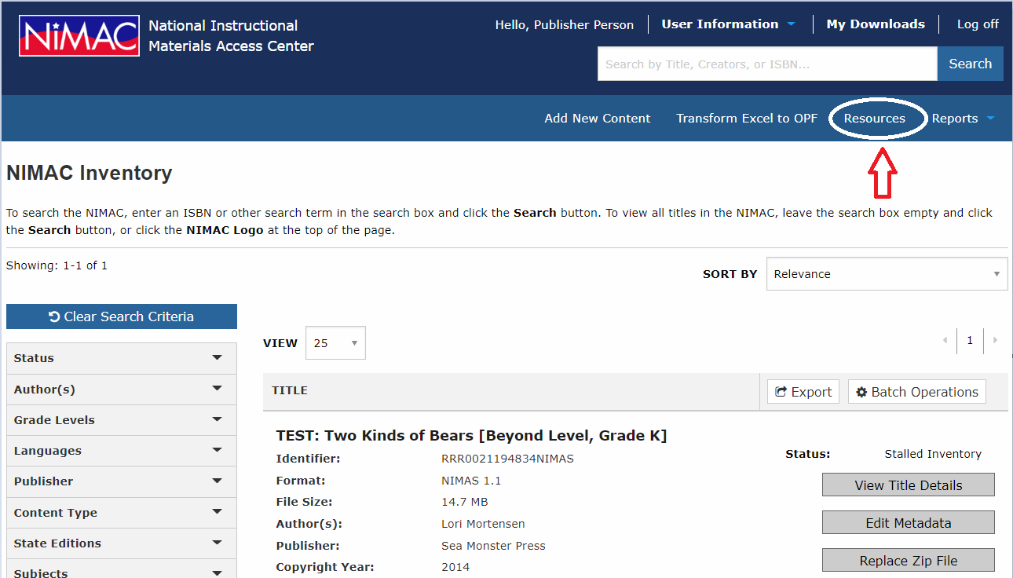
The Validation Wizard can be downloaded at any time from the Resources page in the system.

Slide 6
How to Use the Tool
Once you have installed the tool on your machine, just navigate to the location of the zipped file for the complete NIMAS file set.
Then click the Validate button.
When the validation is complete, the results will display on the screen.
These results can also be exported as a .csv file, if desired.

Slide 7
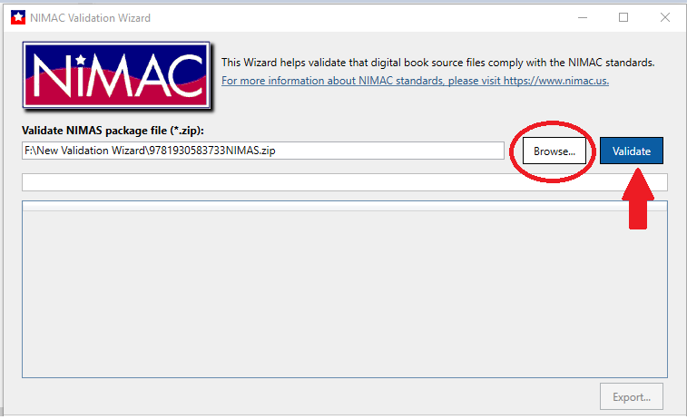
Navigation to the Zipped File

Slide 8
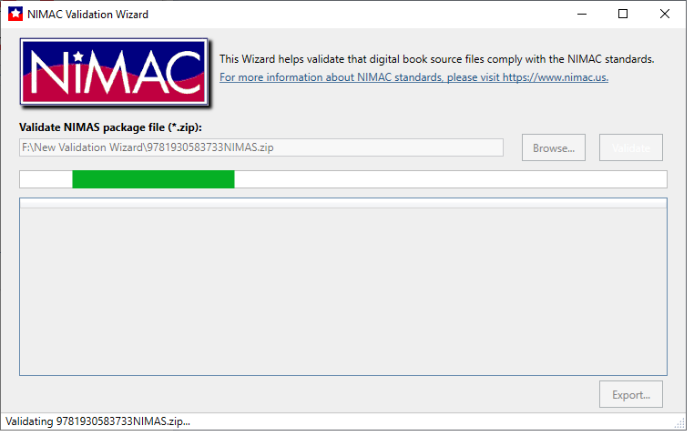
Validation in Progress . . .

Slide 9
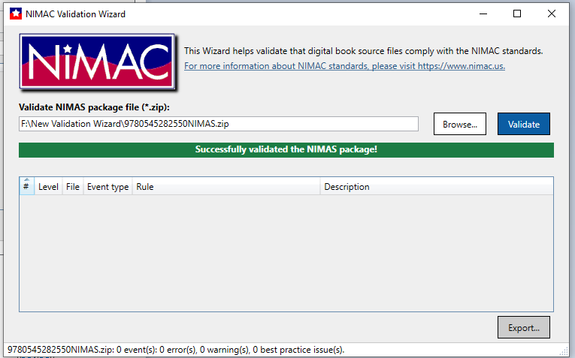
Successful Validation Output

Slide 10
Types of Validation Output
Errors: Must be corrected or file cannot be uploaded to NIMAC system.
Warnings: Correction is recommended but not required.
Best Practice: Information to consider in preparing NIMAS files.

Slide 11
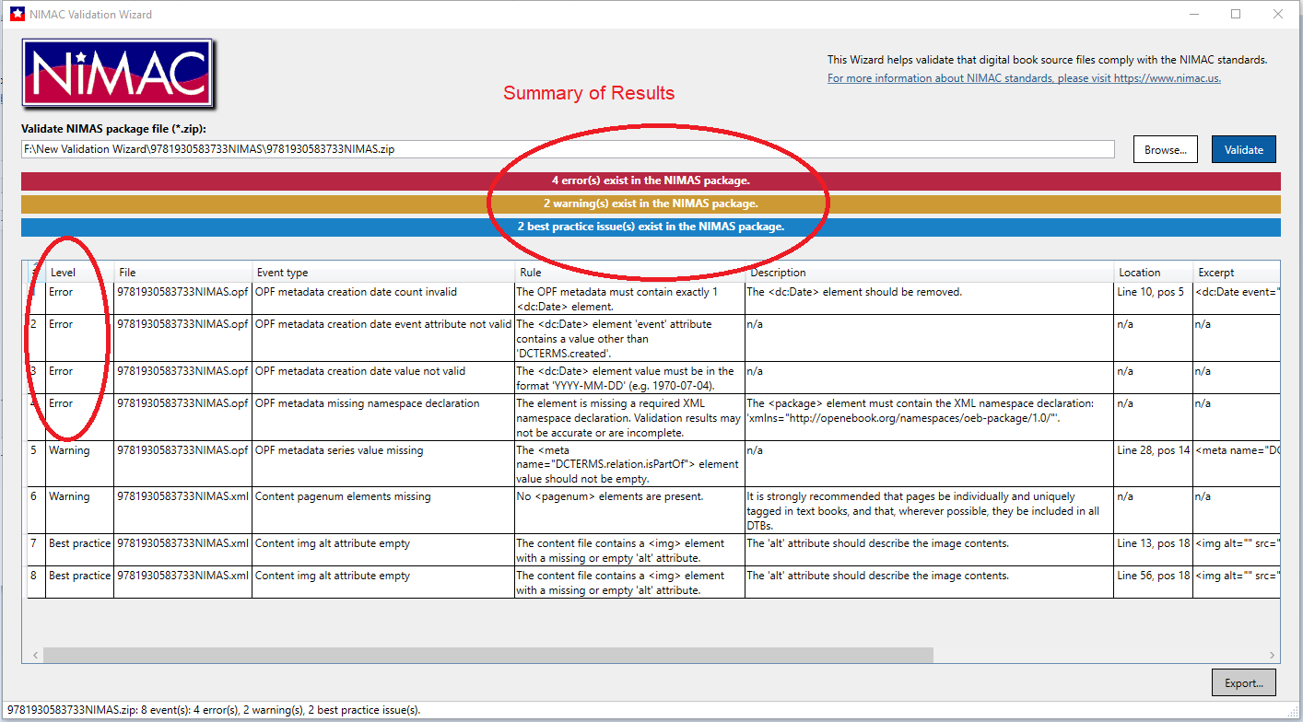
Validation Output Showing Errors

Slide 12
Corrupt Zip Files
Occasionally files will fail upload or batch processing due to the zip files being corrupt.
After zipping your NIMAS file sets, it’s a good idea to check to ensure that the files were not corrupted during the compression process.
Just click on the zip file. If it opens, the file is probably okay and not corrupt.

Slide 13
Questions?
Don’t hesitate to get in touch with us for assistance:
nimac@aph.org
877-526-4622
The contents of this resource was developed under a grant from the US Department of Education, #H327E210001. However, these contents do not necessarily represent the policy of the US Department of Education, and the reader should not assume endorsement by the Federal Government. Project Officer: Rebecca Sheffield.

