Slide 1

The NIMAC for AUs:
Basics, Updates, and a Demo
Liz Schaller, NIMAC Manager
eschaller@aph.org
Alexa Miller
amiller@aph.org
March 12, 2025

Slide 2
Today’s Webinar
Part 1: PowerPoint
  NIMAC Basics
  Policy and Specification Updates
  Services & System Features for AUs
  Working with NIMAS
Part 2: Live Demo!
  Searching and Downloading
  Assigning Files to an AMP
  Using the Watchlist
  Publisher & AMP Contact Information
  Adding temporary sub users
  Reports

Slide 3
NIMAC: The Basics

Slide 4
The NIMAC Project
  Created by IDEA 2004, the NIMAC is the national source file repository for K-12 textbooks and instructional materials.
  We make NIMAS files available for use in producing accessible formats for K-12 instructional materials.
  We have over 82,000 file sets from over 200 publishers.
  All 50 states plus the eligible territories and DoDEA work with the NIMAC.

Slide 5
What is NIMAS?
  “NIMAS” means the National Instructional Materials Accessibility Standard.
  Under IDEA, this is the only file format the NIMAC is allowed to receive.
  NIMAS is an XML-based source file format used to produce accessible formats such as braille, DAISY, EPUB, and large print.
  It is not distributed directly to students.
  Because NIMAS is not generated as a part of print or digital book production, it can take several weeks for it to be produced.

Slide 6
How we get files
  Under IDEA 2004, the only mechanism to require NIMAS from the publisher is the book adoption contract or purchase agreement.
  There is no blanket requirement for publishers to submit files to the NIMAC.
  States and districts have been able to require NIMAS when they purchase new textbooks since July of 2006.
  Ideally, when NIMAS is included in contracts, a file will already be available when a need is identified.

Slide 7
Types of materials we receive
  NIMAC receives a wide range of student-facing instructional materials.
  These include textbooks, workbooks, supplementary readers, and ancillary materials such as blackline masters.
  Exempt materials include teacher’s editions, pre-2006 titles, trade books, college textbooks, reference books.
  We can also now accept NIMAS files for some digital instructional materials.

Slide 8
What is an Authorized User?
An Authorized User is someone who has been designated by their State Coordinator to have an account that provides full access to the NIMAC repository.
These individuals are generally from within the educational structure of the state, such as from an IRC or state department of education.
In some states, the State Coordinator also functions as an Authorized User. We identify these individuals as “hybrid” State Coordinators.

Slide 9
Authorized Users & AMPs
  As an Authorized User, you can search and download files from the NIMAC.
  You can also assign files for download by registered Accessible Media Producers (AMPs).
  AMP accounts are freely available but provide more limited access to the repository.
  We’ll cover assigning files to AMPs in the demo.

Slide 10
TVI Account Pilot Program
This spring, the NIMAC is piloting a new TVI account type with four states: Alaska, Hawaii, Maryland, and Pennsylvania.
The goal is to provide access for teachers who need to produce on-the-fly braille for immediate student needs.
The NIMAC will share more information as the pilot program gets underway, including a timeline for when the TVI account type will be made available to all states.

Slide 11
NIMAC Specification Updates

Slide 12
NIMAS Specification Updates
The NIMAS specification is defined in the IDEA regs and updating it requires regulatory or legislative action.
It was originally intended to be an evolving specification, but IDEA is many years behind schedule for reauthorization.
In 2023, we received a supplemental award from OSEP to explore possible updates to the specification.

Slide 13
Report of Recommendations
The gathering of stakeholder input involved surveys, focus groups, and an in-person NIMAS convening in DC this May.
The NIMAC compiled the feedback and provided a report to OSEP in December 2024.
While there may be formal regulatory change at a future point, the timeline is uncertain.
In the meantime, the NIMAC is already using the input to develop new resources for publishers and NIMAC users.

Slide 14
System Features and
Services for AUs

Slide 15
The Watchlist Research &
Expedite Service
  If a file you need is not available in the NIMAC, you may not be certain if it “should” be in the NIMAC or not.
  AU accounts have a built-in system feature where you can add the ISBN of a needed title to your Watchlist.
  NIMAC will research the item for you and try to obtain NIMAS for the title, if the material is within scope for the repository.

Slide 16
Watchlist Research
  If the title is within scope for NIMAS (i.e., not in an exempt category), we will request the file from the publisher.
  If the file is already in production, we may be able to expedite it for you.
  When the requested item becomes available in the NIMAC, you will receive an automated system email to let you know.
  If the file is outside of scope, we will research other accessibility alternatives and provide that information to you.

Slide 17
Side Note: Email Notifications
  The NIMAC system generates emails:
    when a Watchlist item becomes available
    when a sub user account is expiring
    when a download request has been processed and is ready (if you’ve selected this option)
  These emails show as sent by: noreply-NIMAC@overdrive.com
  Adding this address to your email contacts may prevent them from being filtered as spam.
  Contact us if you need further help.

Slide 18
MathML and NIMAS
MathML is optional XML markup for math and scientific notation.
The benefit of MathML is that, when software supports it, it can be used to automatically generate braille or other formats.
In the past, math was most often provided in NIMAS as images, which cannot automatically be converted into braille.

Slide 19
No MathML Download
Many publishers now provide MathML in their NIMAS files--however, not all software supports MathML.
If a NIMAS file includes MathML but your software does not support it, you can choose to download the file without MathML.
We will show you this download option during the demo.

Slide 20
Does the file include MathML?
The NIMAC system will only show a “No MathML” download option if MathML is present in the file.
This is one easy way to know whether a file contains MathML.
There are also two other ways: looking at the system record or the XML file.

Slide 21

1. No MathML Download Option

Slide 22

2. MathML in the system record

Slide 23

3. MathML is mentioned at the top of the XML file

Slide 24
Working with NIMAS

Slide 25
Braille 2000 and Duxbury User Groups
In 2023, the NIMAC started two braille software user groups for transcribers who work with NIMAS.
These quarterly virtual meetings are facilitated by experienced transcribers.
Please reach out to nimac@aph.org for more information!

Slide 26
Free NIMAS to EPUB Conversion Tool
The DAISY Consortium recently improved the NIMAS to EPUB conversion in their free DAISY Pipeline 2 software.
We are interested in hearing your feedback on the tool!
You can download the DAISY Pipeline 2 for either Windows or Mac.
To get you started, the NIMAC has also created a short how-to video.

Slide 27
NIMAS to EPUB Conversion
Here are the steps to follow when you open the Pipeline:
  Script: choose the DTBook to EPUB option
  Navigate to the NIMAS XML file for the file set you want to convert
  Select “No Validation”
  Check the option box for NIMAS input
  Then run the conversion!

Slide 28
Feedback on using the
DAISY Pipeline 2
We welcome any feedback on how well the tool is working with NIMAS files – positive or negative.
Our work with DAISY is on-going, so we want to be sure to report any bugs or other problems.
If you have any issues with getting started, please reach out to nimac@aph.org and we’d be happy to assist!

Slide 29
Additional Training!
The NIMAC is looking for additional ways to support you! We can put together trainings for:
Your state or local team
Your local conference/PD
We would also like to hear from you about topics you’d like to see covered in a live training or reference material. Please email us your ideas at nimac@aph.org!

Slide 30
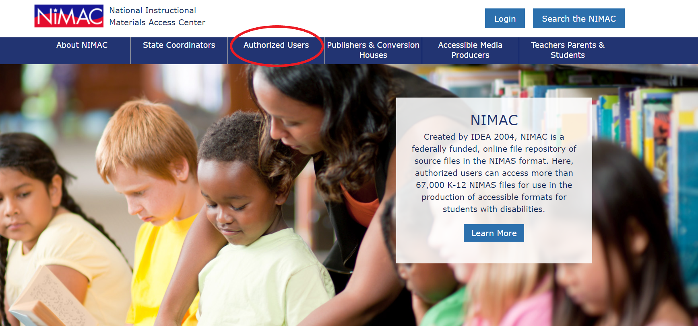
NIMAC Website

Slide 31
Live Demo: Your AU Account

Slide 32
What we’ll cover!
Basics
  Searching
  Downloading
  Assigning Files to an AMP
Additional System Features
  The Watchlist
  Publisher & AMP Contact Information
  Adding sub users
  Reports

Slide 33
Any Questions?
For any questions about how to use NIMAC or the status of files in the NIMAC system please contact us for assistance:
nimac@aph.org
877-526-4622
The content of this resource was developed under a grant from the US Department of Education, #H327E210001. However, these contents do not necessarily represent the policy of the US Department of Education, and the reader should not assume endorsement by the Federal Government. Project Officer: Rebecca Sheffield.

